Slide 1

Teen Driving Issues
Invest Class

Slide 2


Teen Driving Issues
Young operators of vehicles are disproportionately affected by automobile accidents. Their accident rates are higher, fatality rates higher, and the incidence of alcohol-related deaths is higher than the general population.

Slide 3
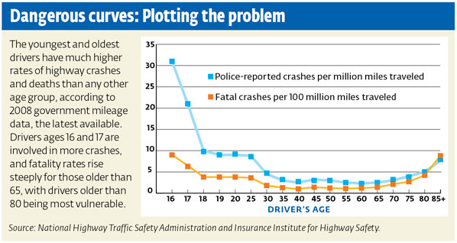

Young Drivers are Most Vulnerable to Accidents

Slide 4
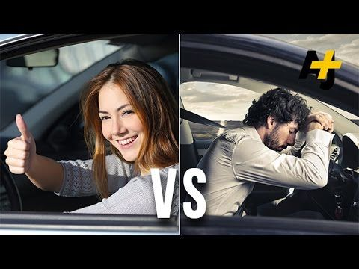
Male vs. Female Drivers
About 2 out of every 3 teenagers killed in crashes in 2011 were males.
Male teenagers tend to driver riskier than their female counterparts.

Slide 5
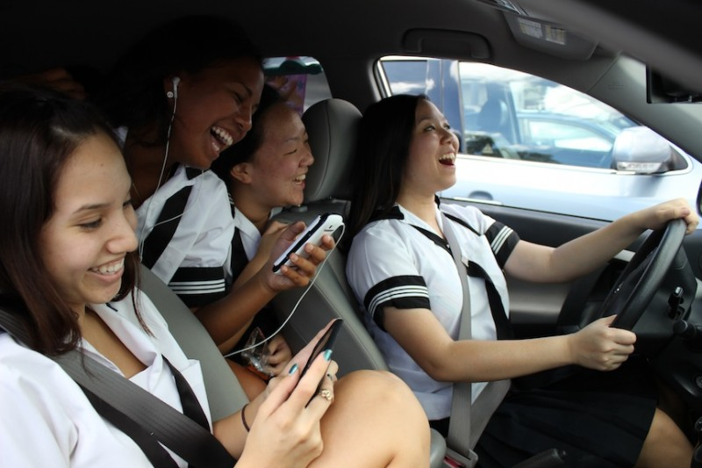
Distracted Driving
In 2011, 11 percent of all drivers 15 to 19 years old involved in fatal crashes were distracted at the time of the crash. Among the distracted drivers 15 to 19 years old, 21 percent were distracted by the use of cellphones at the time of the crash.

Slide 6
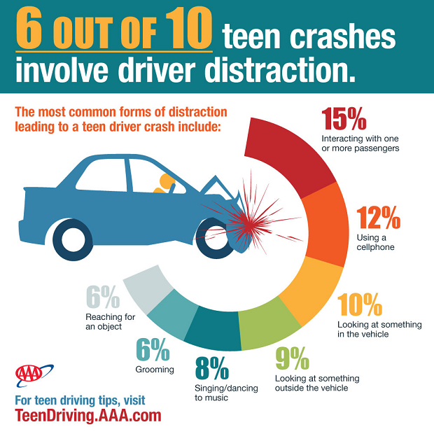

Slide 7
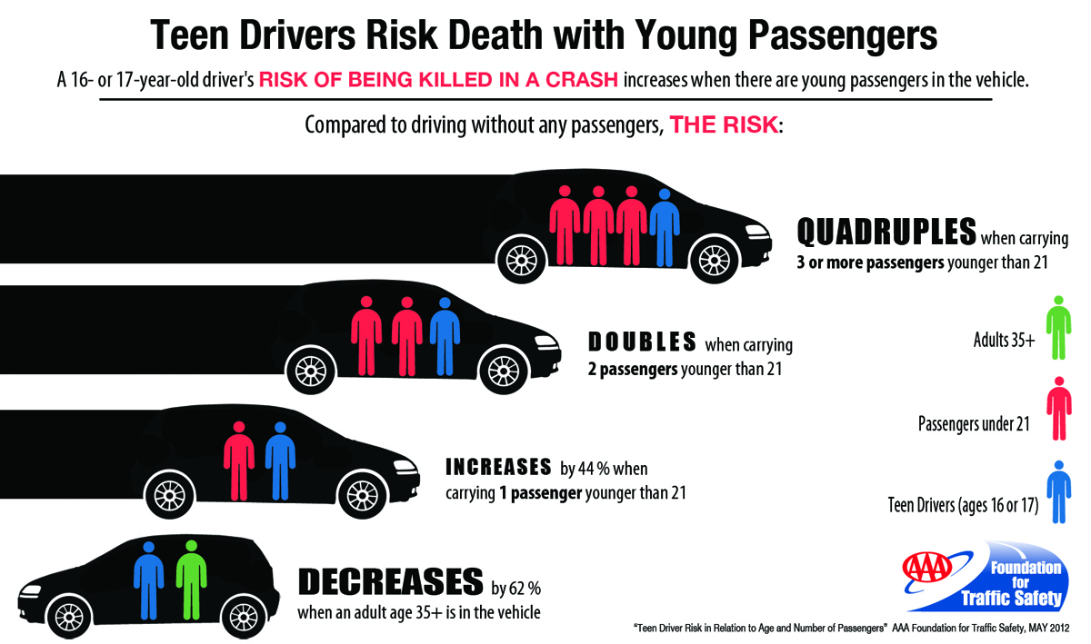
Driving with Passengers
Notes:
The AAA Foundation for Traffic Safety released a report in May 2012 that showed that the risk of 16- or 17-year old drivers being killed in a crash increases with each additional teenage passenger in the vehicle. The risk increases 44 percent with one passenger; it doubles with two passengers, and quadruples with three or more passengers. The study analyzed crash data and the number of miles driven by 16- and 17-year olds.

Slide 8
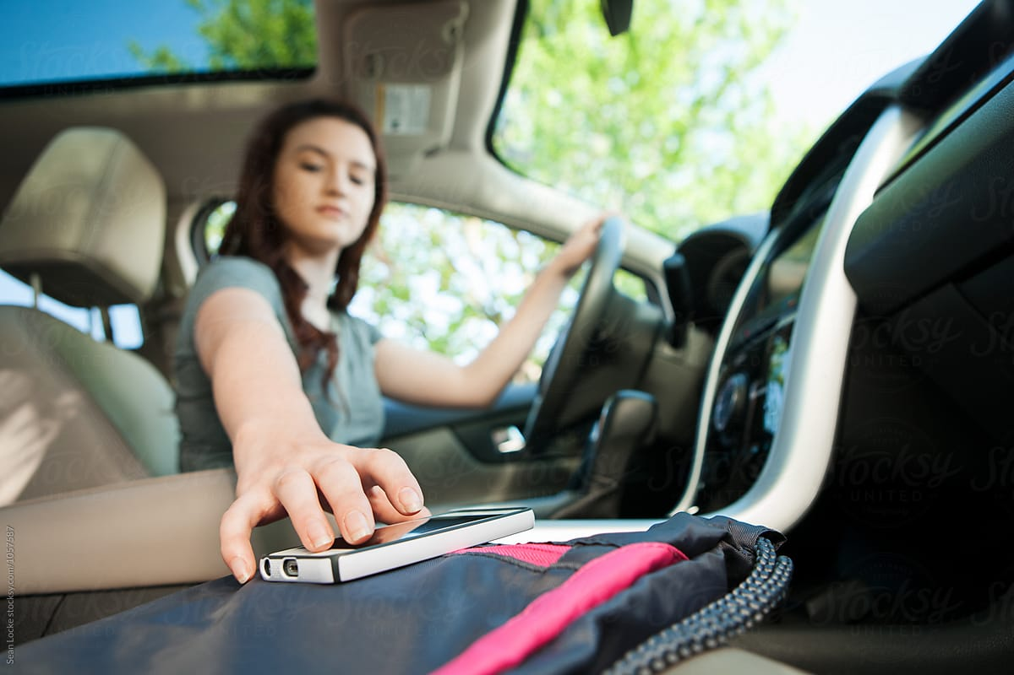
Texting and Driving
While it may take only a few seconds to send a quick text, when you’re driving a vehicle at fast speeds it can be deadly.

Slide 9
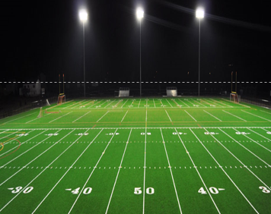
Texting and Driving
If you send a text that takes five seconds to write, while driving 55 MPH, you’ve traveled the length of a football field while not looking at the road.

Slide 10
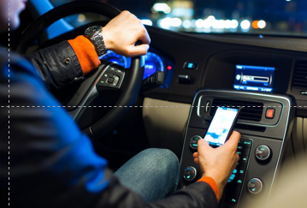
Texting and Driving
You are 23% more likely to get into an accident while texting.
Using a cellphone while driving delays a driver’s reaction as much as driving with an alcohol level of .08 (the legal limit in most states).

Slide 11
Cellphone Use While Driving Laws
Hand-held Cell Phone Use: 12 states, D.C., Puerto Rico, Guam and the U.S. Virgin Islands prohibit all drivers from using hand-held cell phones while driving. Beginning in October 2013, all laws are primary enforcement—an officer may cite a driver for using a hand-held cell phone without any other traffic offense taking place.
All Cell Phone Use: No state bans all cell phone use for all drivers, but 37 states and D.C. ban all cell phone use by novice drivers, and 20 states and D.C. prohibit it for school bus drivers.
T ext Messaging: Washington was the first state to pass a texting ban. Currently, 42 states, D.C., Puerto Rico, Guam and the U.S. Virgin Islands ban text messaging for all drivers. An additional 5 states prohibit text messaging by novice drivers.
3 states restrict school bus drivers from texting.
Notes:
Novice driver – someone who has a learners permit or provisional licenses

Slide 12
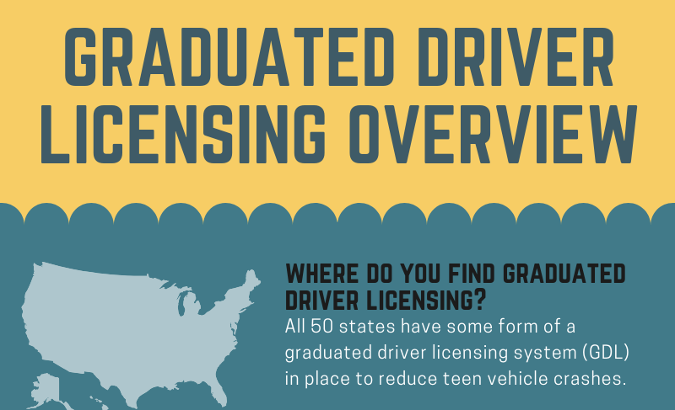
Graduated Licensing
Teenage motor vehicle crash deaths in 2011 occurred most often from 9 pm to midnight (16%) and midnight to 3 am (16%).
Graduated licensing laws help limit the exposure of young people during their most risky time.

Slide 13
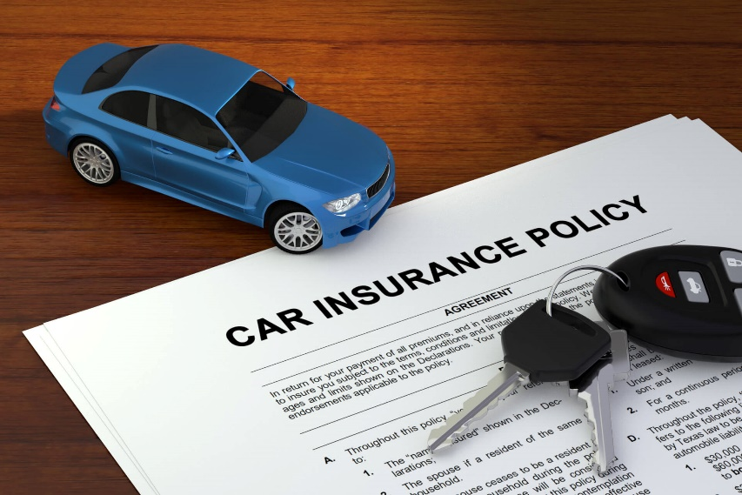
Auto Insurance for Young Drivers
Because of the higher accident rate for young drivers, insurance premiums tend to be higher
This increases if the insured is a male teenager
Many insurance companies offer good student discounts

