Slide 1



An Introduction to Invest

Slide 2

What is Invest?
A non-profit organization dedicated to improving insurance literacy of students and attracting diverse new talent to the industry
Supported by over 100 insurance companies and organizations

Slide 3

Over the next 6 weeks, you will…
Learn insurance basics
Managing risk
Issues in Auto Insurance
What’s in a Personal Auto Policy
How an Insurance Agency Operates
Insurance Careers
Marketing and Selling Insurance
Real life job skills

Slide 4

You Will…
Hear from educated and distinguished guest speakers
from the insurance industry
Play games on the computer
Learn how to present
yourself during a job interview
with a mock interview
Simulate an insurance environment

Slide 5

Scholarship Dollars
By completing this six-week program, you are also eligible for scholarship dollars through Invest
www.investprogram.org/scholarships

Slide 6
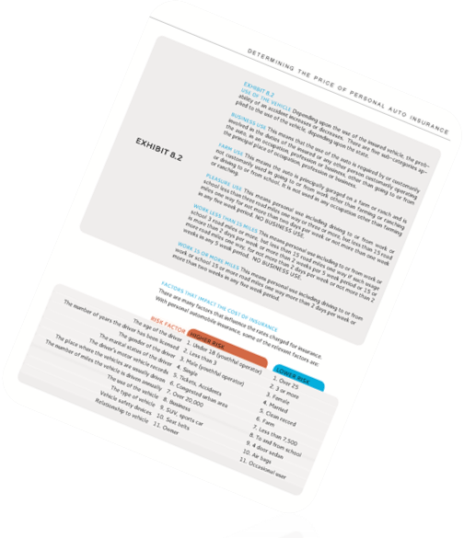
Your Resources
The Invest Textbook or E-book
Rating Software
Explore Career options
www.investprogram.org

Slide 7

Lets Get Started!
Using your computer, go to investprogram.org
Click on ‘Course Material’ tab and Log in
Try the ‘Risk and Probability’ Game
Notes:
Depending on how much time you have in class, the students could play the game multiple times.

