Slide 1
Insurance 101: Risks and Perils
DECA Classroom Connection
Lesson plan available at www.investprogram.org/classroomconnection
Notes:
Download lesson plan
www.investprogram.org/classroomconnection
Time: 25 to 50 minutes
25 minutes – Risks and Perils Activity including Basic Insurance Terms
Optional Introductory Instruction
15 minutes – Introductions with Insurance Professional Volunteers
10 minutes – Basic Overview of Insurance

Slide 2
::: Volunteer Introductions :::
Name, Company +
What do you do in the
insurance industry?
Notes:
Optional Introductory Content
*Ask insurance professionals “what they do in the industry?
Other potential questions: How did they get started in the insurance industry? What’s the biggest skill someone needs to have to be successful in your job? Share one of the most memorable times you have had in your current job? Where do you see yourself in the next 3-5 years in your career? What do you think is the biggest myth about the insurance industry?

Slide 3
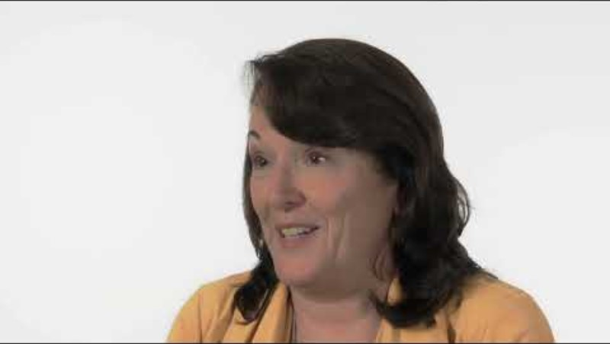
Why Should You Consider an Insurance Career?
Notes:
Optional Introductory Content
*Have students watch this video (2 minutes and 40 seconds) with several insurance professionals discussing why choose a career in insurance
Link to video: https://www.youtube.com/watch?v=9RuN4lysvVI&t=3s

Slide 4
::: Student Introductions :::
Name, Grade +
Where Do You See
Yourself in 10 Years?
Notes:
Optional Introductory Content
*Have students introduce themselves to insurance professional volunteers including their grade level and where they see themselves in 10 years.

Slide 5
Your Turn…
What do you know about Insurance?
Notes:
Optional Introductory Content: Basic Overview of Insurance
*Have a few students answer: What do you know about insurance?

Slide 6


Basic Principles of Insurance
Invest
Insurance 101
Notes:
Optional Introductory Content: Basic Overview of Insurance
*Have students watch this video (1 minute and 52 seconds) providing an overview of the business of insurance
Link to video: https://www.youtube.com/watch?v=IbhuV9xS8vc&t=111s

Slide 7
What Is Insurance?
Invest
Insurance 101
Insurance is a social and contractual device that transfers the risk of a financial loss from individuals or businesses to an insurer.
Notes:
Optional Introductory Content: Basic Overview of Insurance
*Ask a student to read aloud the definition of insurance.
What is Insurance
Insurance is a social and contractual device that transfers the risk of a financial loss from individuals or businesses to an insurer.
It is important to know that insurance is a contract.

Slide 8
Your Turn…
Why is Insurance Important?
Notes:
Optional Introductory Content: Basic Overview of Insurance
*Have a few students answer: Why is Insurance Important?

Slide 9
Why is Insurance Important?
Invest
Insurance 101
Pays for a loss.
Restores standards of living for individuals.
Helps businesses resume operations.
Indemnifies consumers by restoring an insured person or organization to the same financial condition they were in before the loss happened.
Notes:
Optional Introductory Content: Basic Overview of Insurance
Why is Insurance Important
Pay insured people for a loss: Today, insurance functions as a way of reimbursing people when they suffer an unforeseen loss.
Restores standards of living for individuals.
Helps businesses resume their standard operations.
Indemnifies consumers by restoring an insured person or organization to the same financial condition they were in before a loss happened.

Slide 10
Benefits & Costs of Insurance
Invest
Insurance 101
For Example…
Could your family afford another house if it burned down?
Not only would you be affected without insurance, other businesses would also be affected.
There would be a negative ripple effect on the economy.
Notes:
Optional Introductory Content: Basic Overview of Insurance
Benefits and Costs of Insurance
If your house burned down, what would happen?
If your house burned down and you didn’t have insurance, your family may not be able to pay for the repairs and would be unlikely to have the funds to purchase another home.
Not only would you be affected without insurance, other businesses would also be affected.
There would be a negative ripple effect on the economy.

Slide 11

Basic Insurance Terms
Invest
Insurance 101
Understanding insurance requires a comprehensive understanding of these fundamental principles:
  Insurance
  Risk
  Peril
  Hazard
Notes:
Core Instructional Content: Risks and Perils
Basic Insurance Terms
Insurance (Previously Discussed)
Risk
Peril
Hazard
Loss

Slide 12
Your Turn…
What does
risk mean?
Notes:
Core Instructional Content: Risk and Perils
*Have a few students answer: What does risk mean?

Slide 13

What is Risk?
Invest
Insurance 101
A risk is the possibility of a loss.
There are two types of risk:
Pure Risk and Speculative Risk
Taking a risk means not knowing
exactly what will happen.
Notes:
Core Instructional Content: Risk and Perils
What is Risk
A risk is the possibility of a loss. It exists whenever there is an uncertainty about an outcome.
“Taking a risk” means not knowing exactly what will happen.
Facing risks is part of life, and is the basic problem dealt with insurance.

Slide 14
Pure vs Speculative Risk
Invest
Insurance 101
Pure risk is the only insurable type of risk. It exists whenever there are only two possible outcomes: loss or no loss.
Speculative risk is not an insurable risk because it includes a third possible outcome, gain.
  Example of Speculative Risk: Purchasing your company’s stock, the value of the stock could decline (loss), it could stay the same (no loss) or it could appreciate (gain)
  The potential for gain or profit is a violation of the general principles of insurable interest and indemnity.
Notes:
Core Instructional Content: Risk and Perils
Pure vs Speculative Risk
Risk comes in two forms: Pure and Speculative Risk
Pure risk is the only insurable type of risk. It exists whenever there are only two possible outcomes: loss or no loss.
Speculative risk is not an insurable risk because it includes a third possible outcome, gain.
Example of Speculative Risk: Purchasing your company’s stock, the value of the stock could decline (loss), it could stay the same (no loss) or it could appreciate (gain)
The potential for gain or profit is a violation of the general principles of insurable interest and indemnity.

Slide 15


What is a Peril?
Invest
Insurance 101
A Peril is the cause of a loss.
Types of perils include:
  Fire
  Flood
  Theft
  Earthquake
Notes:
Core Instructional Content: Risk and Perils
What is a Peril?
A Peril is the cause of a loss.
Types of perils include:
Fire
Flood
Theft
Earthquake

Slide 16
Risk vs Peril in Summary
Invest
Insurance 101
A risk is the possibility of a loss, but a peril is a cause of loss.
Notes:
Core Instructional Content: Risk and Perils
*Ask a student to read aloud the definition of hazard
Risk vs Peril in Summary
A risk is the possibility of a loss, but a peril is a cause of loss

Slide 17
Did you know…
Invest
Insurance 101
A hazard is a condition that makes a peril more likely to happen or that increases the probability of a loss.
Notes:
Core Instructional Content: Risk and Perils
*Ask a student to read aloud what a hazard is
What is a Hazard
A hazard is a condition that makes a peril more likely to happen or that increases the probability of a loss.
Examples of hazards:
Leaving the door to your house unlocked when no one is there is a hazard since it increases the likelihood that a theft will take place.

Slide 18
Approx 15 minutes
Risk or Peril
Group Activity
Directions: Identify whether the images are an example of a risk or a peril and why.

Slide 19
Directions:
Each team must assign the following roles
Scribe: The scribe’s role is to write your group’s explanation on a notecard or piece of paper.
Speaker: The speaker shares out your group’s explanation.
In teams, identify whether the pictures following are examples of a risk or a peril and an explanation to justify your answer. You gain (1) point if you are the first team to correctly identify if the picture is a risk or a peril. You gain (1) additional point for a correct explanation.
The first group to identify the correct choice earns a point for the round, but other groups can earn a point if they answered if it is a risk or peril correctly AND have a good explanation of why, so be thorough!
Notes:
Core Instructional Content: Risk and Perils Activity – Approximately 15 minutes
Students will divide into teams where they will identify if the pictures on each slide are examples of a risk or a peril. For each picture they also must come up with an explanation to justify their answer on if it is a risk or peril. Each team must assign a scribe and a speaker.
The scribe’s role is to write the team’s answer (risk or peril) along with an explanation (why is it a risk or peril) on a piece of paper or notecard. The speaker’s role is to share out loud their team’s explanation.
RULES
The first Risk or Peril…and Why? slide is shown. Each team’s scribe must write a complete answer including if it is a risk or peril and explain why before their team speaker can stand up. All the speakers must be standing before the first team’s speaker is allowed to share their answer. The instructor must pay attention to which group’s speaker was the first to stand up. Then, the speaker shares whether the slide shown was a “Risk or Peril…and Why?”
If the first team’s speaker answers correctly on if it is a risk or peril they are given 1 point. If they also provide a credible explanation on why it’s a risk or peril they are given an additional 1 point, for a total of 2 points.
The other teams are then given an opportunity to score 1 point if they correctly answer if it is a risk or peril AND also provide a credible explanation on why it is a risk or peril.
The next round begins showing the next Risk or Peril…and Why? slide.
One point – risk or peril is only given to the first team that correctly answers if it is a risk or peril. They are also given an additional point if they provide a credible explanation as to why it is a risk or peril.
One point – explanation is given to all teams that correctly answered if it was a risk or peril AND provide a credible explanation on why it is a risk or peril.
Frequently Asked Questions
What if the first team to stand answer’s incorrectly on if it’s a risk or peril? The second team to stand has an opportunity to answer with the potential of receiving 2 points. The remaining teams then have an opportunity to score 1 point if they correctly answer both if it was a risk or peril correctly AND also provide a credible explanation on why it is a risk or peril.
What if a team answer’s incorrectly if it’s a risk or peril but provides a credible explanation? No points are earned as they got the initial question wrong.
What if the first team answer’s correctly on it being a risk or peril but doesn’t provide a credible explanation? They only score 1 point.
What if the team speaker says something different from what was written by the scribe? They are disqualified from that round and get no points.
What if the team speaker stands before the scribe has completed writing? They are disqualified from that round and get no points.

Slide 20

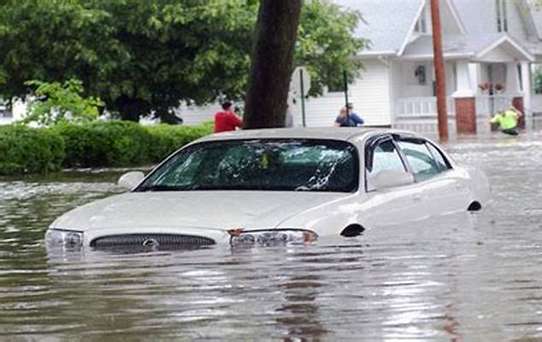
Example!
points!
Is it a Risk or Peril…
Peril
Explain Why…
The car is stuck in water which was caused by a flood – natural disaster
Notes:
Core Instructional Content: Risk and Perils Activity – Approximately 15 minutes
Students will divide into teams where they will identify if the pictures on each slide are examples of a risk or a peril. For each picture they also must come up with an explanation to justify their answer on if it is a risk or peril. Each team must assign a scribe and a speaker.
The scribe’s role is to write the team’s answer (risk or peril) along with an explanation (why is it a risk or peril) on a piece of paper or notecard. The speaker’s role is to share out loud their team’s explanation.
RULES
The first Risk or Peril…and Why? slide is shown. Each team’s scribe must write a complete answer including if it is a risk or peril and explain why before their team speaker can stand up. All the speakers must be standing before the first team’s speaker is allowed to share their answer. The instructor must pay attention to which group’s speaker was the first to stand up. Then, the speaker shares whether the slide shown was a “Risk or Peril…and Why?”
If the first team’s speaker answers correctly on if it is a risk or peril they are given 1 point. If they also provide a credible explanation on why it’s a risk or peril they are given an additional 1 point, for a total of 2 points.
The other teams are then given an opportunity to score 1 point if they correctly answer if it is a risk or peril AND also provide a credible explanation on why it is a risk or peril.
The next round begins showing the next Risk or Peril…and Why? slide.
One point – risk or peril is only given to the first team that correctly answers if it is a risk or peril. They are also given an additional point if they provide a credible explanation as to why it is a risk or peril.
One point – explanation is given to all teams that correctly answered if it was a risk or peril AND provide a credible explanation on why it is a risk or peril.
Frequently Asked Questions
What if the first team to stand answer’s incorrectly on if it’s a risk or peril? The second team to stand has an opportunity to answer with the potential of receiving 2 points. The remaining teams then have an opportunity to score 1 point if they correctly answer both if it was a risk or peril correctly AND also provide a credible explanation on why it is a risk or peril.
What if a team answer’s incorrectly if it’s a risk or peril but provides a credible explanation? No points are earned as they got the initial question wrong.
What if the first team answer’s correctly on it being a risk or peril but doesn’t provide a credible explanation? They only score 1 point.
What if the team speaker says something different from what was written by the scribe? They are disqualified from that round and get no points.
What if the team speaker stands before the scribe has completed writing? They are disqualified from that round and get no points.

Slide 21
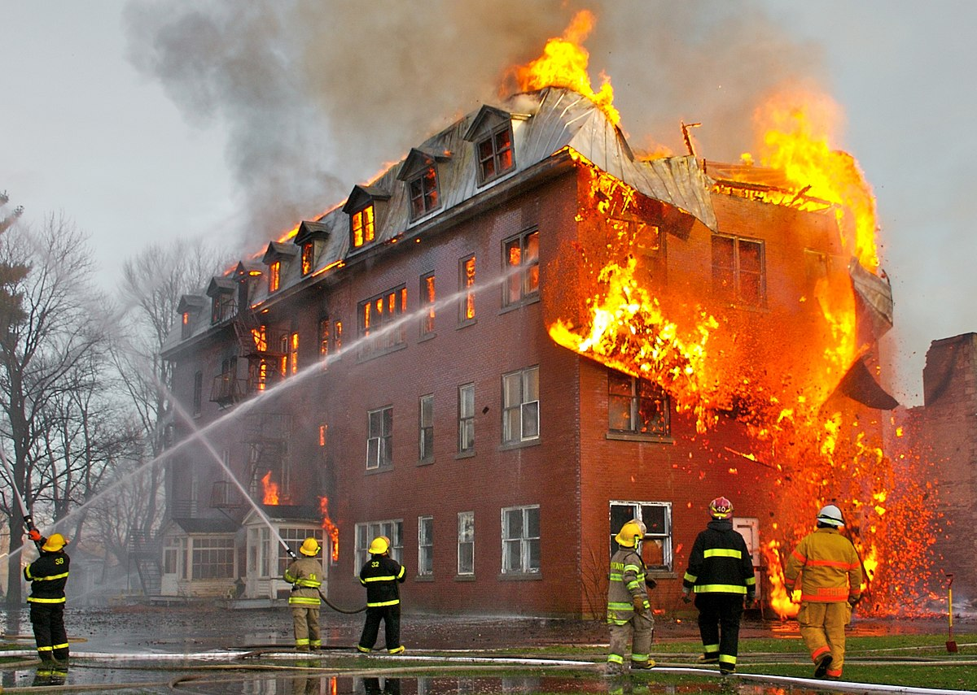
Risk or Peril …and Why?
Notes:
Peril

Slide 22
Peril…and Why?
Notes:
Peril
A Peril is the cause of a loss. Fire is a peril. The building is being burnt down by a fire is an example of a loss.
Types of perils include:
Fire
Flood
Theft
Earthquake

Slide 23

Risk or Peril …and Why?
Notes:
Risk

Slide 24
Risk! And Why?
Notes:
Pure Risk
There is a possibility of a loss – the person getting in a biking accident b/c of being distracted with phone
Pure risk is the only insurable type of risk. It exists whenever there are only two possible outcomes: loss or no loss.
Reminder Speculative risk is not an insurable risk because it includes a third possible outcome, gain.
Example of Speculative Risk: Purchasing your company’s stock, the value of the stock could decline (loss), it could stay the same (no loss) or it could appreciate (gain)

Slide 25
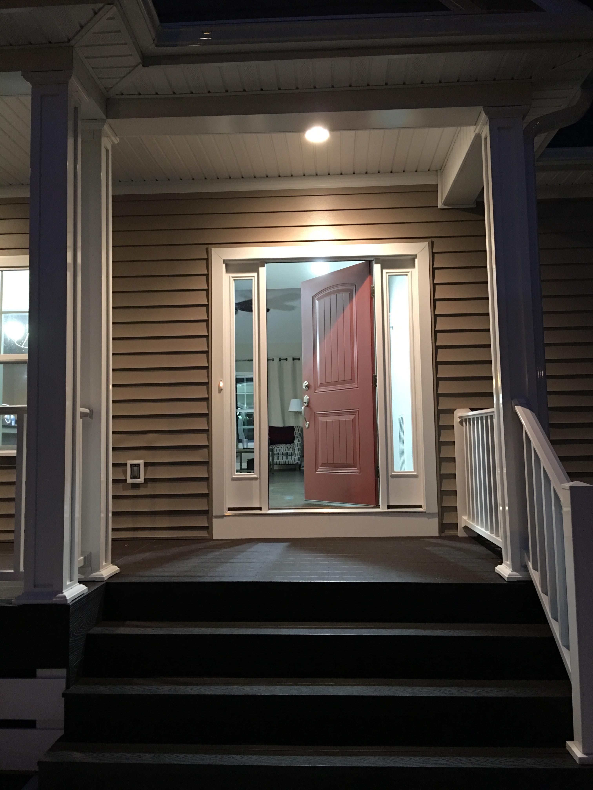
Risk or Peril …and Why?
Notes:
Peril

Slide 26
Risk! And Why?
Notes:
Risk
There is a possibility of a loss – a stranger /uninvited guest coming into your home.
Also qualifies as pure risk which is the only insurable type of risk. It exists whenever there are only two possible outcomes: loss or no loss.
Reminder Speculative risk is not an insurable risk because it includes a third possible outcome, gain.
Example of Speculative Risk: Purchasing your company’s stock, the value of the stock could decline (loss), it could stay the same (no loss) or it could appreciate (gain)

Slide 27

Risk or Peril …and Why?
Notes:
Risk

Slide 28
Peril…and Why?
Notes:
Peril
A Peril is the cause of a loss. Theft is a peril
Types of perils include:
Fire
Flood
Theft
Earthquake

Slide 29
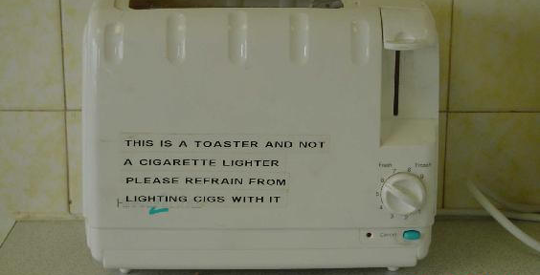
Risk or Peril …and Why?
Notes:
Risk

Slide 30
Risk! And Why?
Notes:
Risk
There is a possibility of a loss – a fire being started.
Also qualifies as pure risk which is the only insurable type of risk. It exists whenever there are only two possible outcomes: loss or no loss.
Reminder Speculative risk is not an insurable risk because it includes a third possible outcome, gain.
Example of Speculative Risk: Purchasing your company’s stock, the value of the stock could decline (loss), it could stay the same (no loss) or it could appreciate (gain)

Slide 31
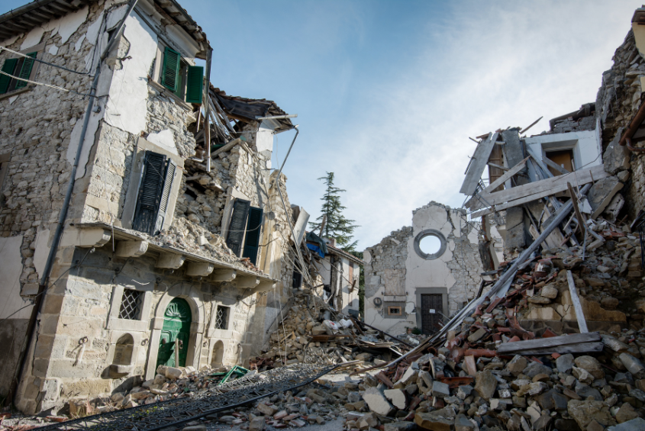
Risk or Peril …and Why?
Notes:
Peril

Slide 32
Peril…and Why?
Notes:
Peril
A Peril is the cause of a loss. Earthquake is a peril – natural disasters are perils.
Types of perils include:
Fire
Flood
Theft
Earthquake

Slide 33
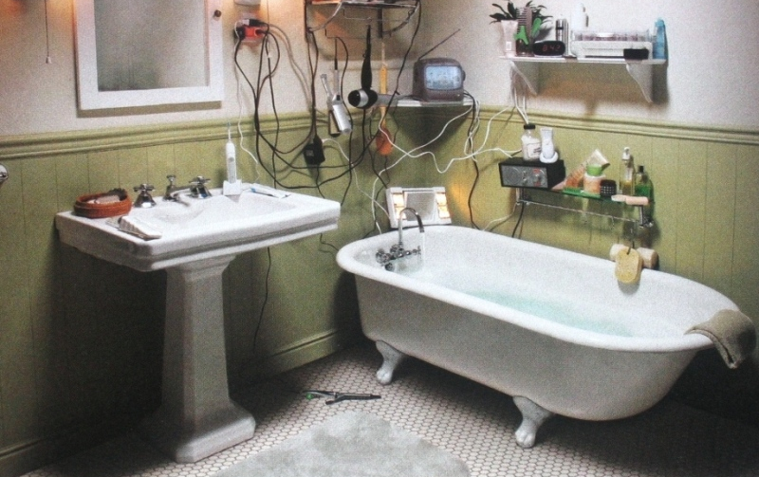
Risk or Peril …and Why?
Notes:
Risk

Slide 34
Risk! And Why?
Notes:
Risk
There is a possibility of a loss – an electrical fire
Also qualifies as pure risk which is the only insurable type of risk. It exists whenever there are only two possible outcomes: loss or no loss.
Reminder Speculative risk is not an insurable risk because it includes a third possible outcome, gain.
Example of Speculative Risk: Purchasing your company’s stock, the value of the stock could decline (loss), it could stay the same (no loss) or it could appreciate (gain)

Slide 35
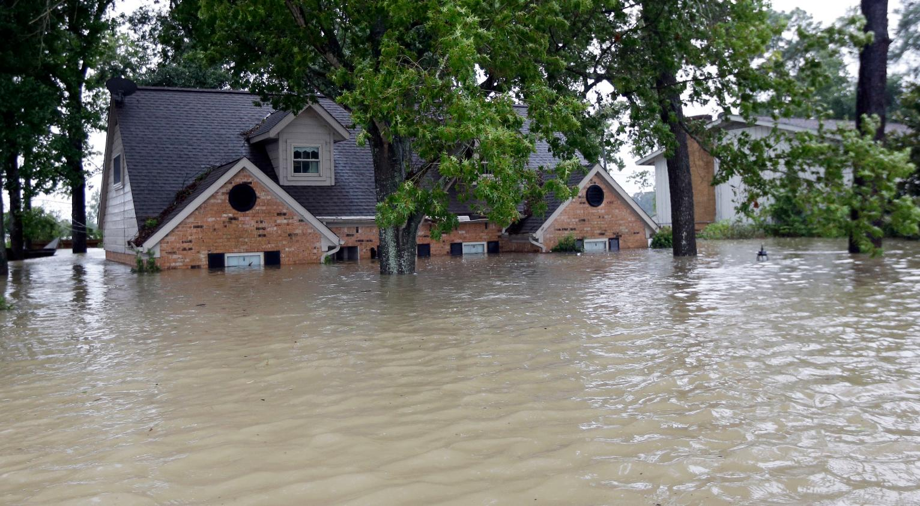
Risk or Peril …and Why?
Notes:
Peril

Slide 36
Peril…and Why?
Notes:
Peril
A Peril is the cause of a loss. Flood is a peril – natural disasters are perils.
Types of perils include:
Fire
Flood
Theft
Earthquake

Slide 37
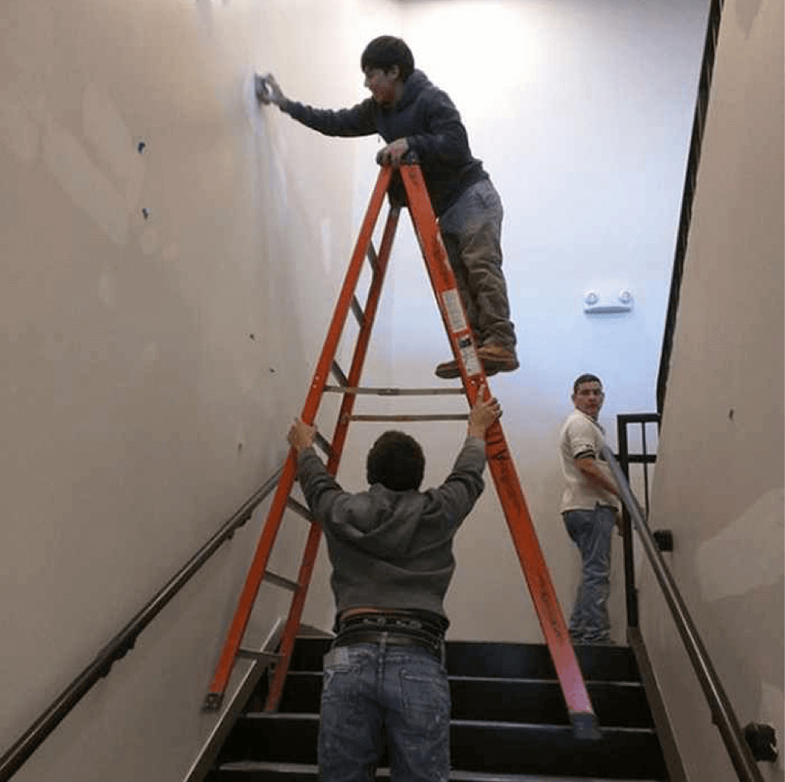
Risk or Peril …and Why?
Notes:
Risk

Slide 38
Risk! And Why?
Notes:
Pure Risk
There is a possibility of a loss – the person falling
Also qualifies as pure risk which is the only insurable type of risk. It exists whenever there are only two possible outcomes: loss or no loss.
Reminder Speculative risk is not an insurable risk because it includes a third possible outcome, gain.
Example of Speculative Risk: Purchasing your company’s stock, the value of the stock could decline (loss), it could stay the same (no loss) or it could appreciate (gain)

Slide 39
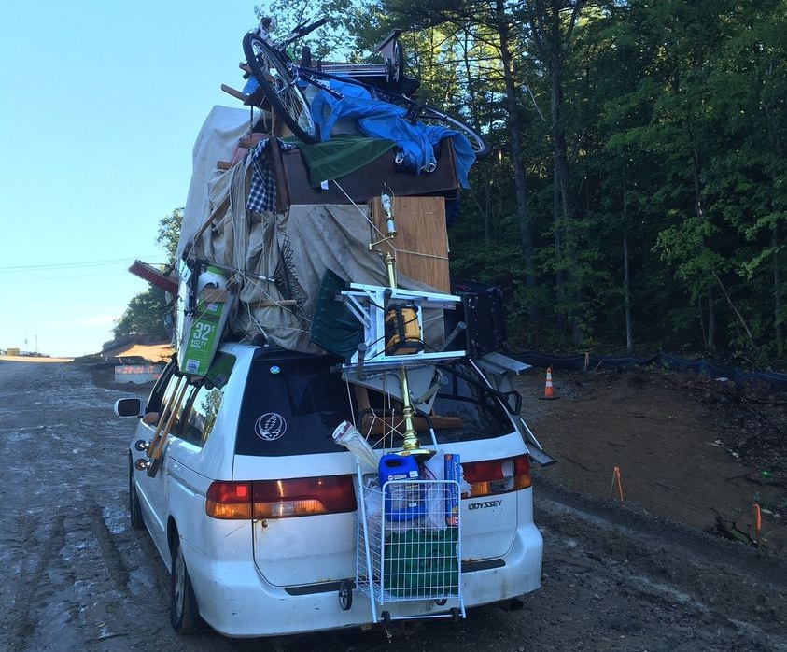
Risk or Peril …and Why?
Notes:
Risk

Slide 40
Risk! And Why?
Notes:
Pure Risk
There is a possibility of a loss – the person’s stuff could fall off the car or prevent from seeing causing an accident.
Pure risk is the only insurable type of risk. It exists whenever there are only two possible outcomes: loss or no loss.
Reminder Speculative risk is not an insurable risk because it includes a third possible outcome, gain.
Example of Speculative Risk: Purchasing your company’s stock, the value of the stock could decline (loss), it could stay the same (no loss) or it could appreciate (gain)

Slide 41

Risk or Peril …and Why?
Notes:
Peril

Slide 42
Peril!
Notes:
Peril
A Peril is the cause of a loss. Theft is a peril.
Types of perils include:
Fire
Flood
Theft
Earthquake

Slide 43
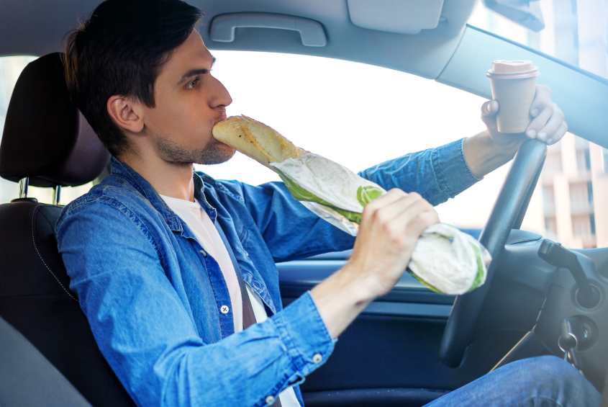
Risk or Peril …and Why?
Notes:
Risk

Slide 44
Risk! And Why?
Notes:
Pure Risk
There is a possibility of a loss – the person getting into a car accident due to distracted driving.
Also qualifies as pure risk which is the only insurable type of risk. It exists whenever there are only two possible outcomes: loss or no loss.
Reminder Speculative risk is not an insurable risk because it includes a third possible outcome, gain.
Example of Speculative Risk: Purchasing your company’s stock, the value of the stock could decline (loss), it could stay the same (no loss) or it could appreciate (gain)

Slide 45
::: Wrap Up :::
What’s something new
you learned today?
Notes:
Optional Wrap Up Content
*Pick a few students to answer: What’s something new you learned today

Slide 46

We need YOU!
400,000 insurance industry professionals are retiring within the next 8 years.
The top challenge insurance agencies are facing in growing their business is the lack of staff.

Slide 47
What is
Early insurance education & career outreach program
Partners with schools and workforce development programs
Provides insurance curriculum and resources to promote insurance literacy and careers
?
Notes:
What is Invest?
Early insurance education and career outreach program
That partners with high schools, community colleges and workforce development programs
To provide educators with free insurance curriculum and resources to promote insurance literacy and careers

Slide 48
Curriculum Overview
  Careers in Insurance
  Agency Operations
  Marketing & Selling Insurance
  Managing Risks
  Car Insurance
  Homeowners & Renters Insurance
  Businessowners Insurance
  Life and Health Insurance
Notes:
Curriculum Overview
Careers in Insurance
Agency Operations
Marketing & Selling Insurance
Managing Risks
Car Insurance
Homeowners & Renters Insurance
Businessowners Insurance
Life and Health Insurance

Slide 49

More Reasons to Bring Invest to Your Classroom
Higher Ed Scholarships
Provides $5,000 and $10,000 to help college bound students planning to major in an insurance related field
Agency Internships
Helps place high school seniors into agency internships with the potential for full time employment upon graduation
Classroom to Careers
Helps reimburse insurance education expenses for high school students wishing to move directly into an insurance career
Notes:
More Reasons to Bring Invest to Your Classroom
Classroom to Careers
Helps reimburse insurance education expenses for high school students wishing to move directly into an insurance career
High Ed Scholarship
Provides $5,000 and $10,000 to help college bound students planning to major in an insurance related field
Agency Internships
Helps place high school seniors into agency internships with the potential for full time employment upon graduation.

Slide 50


Learn More!
Visit www.investprogram.org/deca
Learn how to plug your classroom into the Invest program

