Slide 1
All Kinds of Insurance
& Opportunities
Invest Insurance Education

Slide 2



PET Insurance

Slide 3
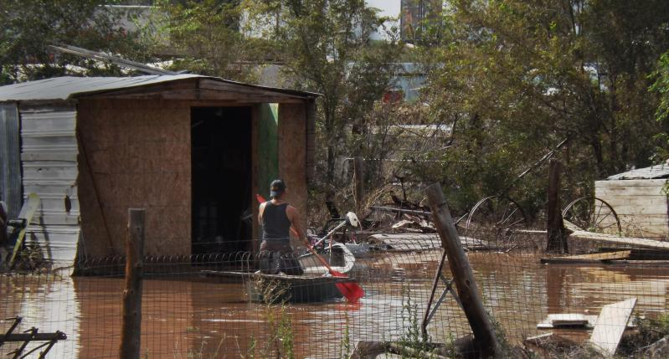


FLOOD Insurance
This Photo by Unknown Author is licensed under CC BY

Slide 4



CYBER Insurance

Slide 5



TRAVEL Insurance

Slide 6



Driverless Cars, Electric Vehicles
& Auto INSURANCE

Slide 7



HOME Insurance

Slide 8

So Many Types
Invest
All Kinds of Insurance
& Opportunities
Architects & Engineers
Auto
Aviation
Builders Risk
Classic Cars
Cyber Liability
Employment Practices
Environmental Liability
Equine
Flood
Homeowners
Hotels & Motels
Life & Health
Liquor Liability
Marine
Product Liability
Public Entities
Publishers Liability
Restaurants & Bars
RVs
Special Event
Trucking
Umbrellas
Workers Comp
Investprogram.org

Slide 9








Lots of Career Choices in INSURANCE
Sales & Marketing
Customer Service
Analytics
Finance
Insurance Agent/Producer
Account Executive
Actuary/Analyst
Finance Professional
Catastrophe Adjusting
Risk Analysis
Engineering
Analaytics
Claims Adjuster
Underwriter
Risk Manager
Technology
Great Careers to Consider

Slide 10




More Career Choices in INSURANCE
Sales & Marketing
Customer Service
Analytics
Finance
Insurance Agent/Producer
Account Executive
Actuary/Analyst
Finance Professional

Slide 11
Technology in Insurance
Cyber Security Analyst
Invest
Insurance 101
A wide variety of duties in the IT department to challenge you.
Monitor all company networks to see if there are any breaches, and if there are, you’ll investigate them.
Install the latest firewalls and data encryption software and do updates to protect sensitive company information.
Provide reports on any security breaches.
Conduct fake cyber attacks to see how secure networks really are.
Research, recommend, and implement new security practices.
Conduct informative security training for staff when needed.
Pleasant working office environment and the ability to also work from home.
A good-paying job within five years of education and work experience.
Excellent salary and positive job outlook.
Investprogram.org
Notes:
Merchants along the Yangtze River in China determined it was too risky to put all of their goods on a single boat and sail it down the river.
So they divided the shipment and loaded it onto several boats (to spread out the risk) and the chance of loss to each unit was minimized.
The formal insurance industry began at a coffee house near London.
Now Lloyds of London is 300 years old and still in business today.

Slide 12

10 Reasons Why an Insurance Career is Great 4 Young People
Invest
All Kinds of Insurance
& Opportunities
There’s a job for your skills
Insurance careers are sustainable
Career advancement provides opportunities to learn
Diversity is welcome
Teamwork is unavoidable
The work is not boring
You will shape what insurance looks like for years to come
Insurance offers a flexible work schedule
You’ll make a difference toward the common good.
Insurance is everywhere
Investprogram.org

Slide 13
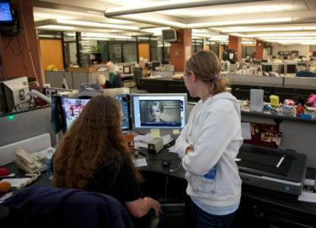
What a Career in
Insurance Offers
Variety: the work is as varied as the customers’ needs. Every day presents unique challenges.
Advancement: potential for growth, professionally and personally, are endless.
Challenge: make a difference by solving problems and helping others in their time of loss. Every day presents a new opportunity and a new challenge.
Lifelong Learning: learn on the job and receive the training you need to reach your earning potential in a high-performance environment.
Stability: insurance is a multi-billion-dollar industry with a long history of growth.
Community: it’s a relationship-driven and a close-knit family of professionals.
Personal Growth & Satisfaction: there’s a place for people who bring caring and commitment to their work. You can succeed professionally, while contributing something positive and necessary.
Inclusive: the industry strives to recruit and develop the broadest possible array of backgrounds from a diverse workforce.
From analytics to marketing and sales to information technology; from damage appraisal and investigation to customer service to human resources and finance to risk management—there's a place for you in insurance. It’s part of everything we do.

Slide 14








Innovation and Trends in Insurance Leading to New Careers
Driveless Cars
Drones
Remote Monitoring
Cyber Risk
Usage based Insurance
Telemedicine
Sharing Economy
Analaytics
Great Careers to Consider

Slide 15

TELEMATICS
Invest
All Kinds of Insurance
& Opportunities
A term that combines telecommunications and informatics.
Onboard communications services in cars, trucks and buses through GPS receivers or apps.
The use of telematics in auto insurance soaring, and nearly 50% of the world’s vehicles expected to be using telematics by 2030.
It helps insurers more accurately estimate accident damages and reduce fraud by enabling them to analyze the driving data (such as hard braking, speed and time) during an accident.
Data collected by telematics can also speed up the claims process, automatically process repair bookings, and even support breakdown recovery.
Telematics also allow fleets of trucks determine the most efficient routes, saving them costs related to personnel, gas and maintenance.
Investprogram.org

Slide 16

Artificial Intelligence (AI)/Chatbots
Invest
Like Siri for brands, chatbots are quickly rising as a new "voice" in consumer communications. These chatty computer programs respond to texts or digital chats.
Insurance firms can organize distribution, claims, and customer support directly into a messaging app that supports millions of users and messages every day.
Provides users an easy way to get the information they need.
Can help an insurance customer register a loss, schedule a survey, provide loss prevention recommendations, arrange emergency assistance during accidents, and even offer disaster assistance.
Since chatbots are basically virtual robots they never get tired and continue to obey your command.
Can simultaneously have conversations with hundreds of people.
Insurers want to use chatbot technology to supplement their call centers and self-service portals.
Chatbots are a low-cost modern channel for consumer interaction.
All Kinds of Insurance
& Opportunities
Investprogram.org

Slide 17

What is InsurTech?
The most visible examples of InsurTech
A movement to transform the insurance industry with new technology to improve customer experience, simplify policy management, and increase competition.
In-car monitoring devices.
Wearable activity trackers.
Customer-facing apps.
SaaS platforms that manage insurance coverage and payment.
In the small business insurance world, InsurTech is working behind the scenes to increase the options business owners have, keep costs low, and speed the delivery of insurance coverage.
Insurance + Technology = #InsurTech
Great Careers to Consider

Slide 18
Thank You!
For More Information
www.investprogram.org
Follow us!
Facebook
Instagram
LinkedIn
@nationalinvest
nationalinvest
www.Linkedin.com/company/nationalinvest

