Slide 1




Business Owner’s Policy

Slide 2

What you will learn
Identify and briefly explain the two main coverage sections of the Business Owner’s Policy (BOP).
How property coverage differs from liability coverage under BOP.
Identify and briefly explain the five major parts of the Business Owner’s Policy.
Identify and explain who qualifies as an insured under BOP.
Identify the two types of property covered and the five categories of properties covered under BOP.
Understand the form open peril basis of BOB and the insurance policy exclusion.
Explain limits of insurance that apply to certain categories of property.
Identify and briefly explain the two types of deductibles under BOP.
Module 11
Learning Objectives

Slide 3

Business Owner’s POLICY
The Insurance Service Organization (ISO) usually develops all policy forms for insurance companies.
Insures small- to medium-size businesses (e.g., “Main Street” type stores).

Slide 4
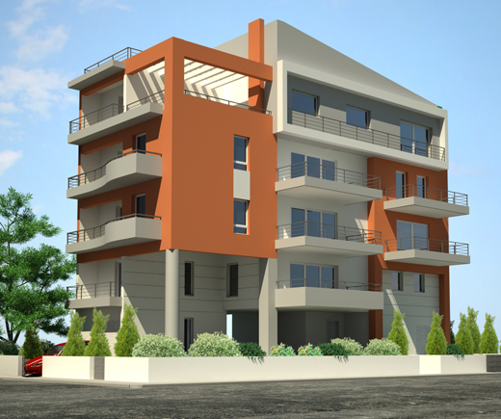
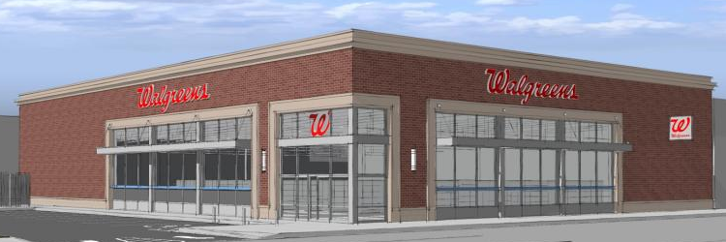
Eligibility FOR BOP
Limited by type of property and size of property.
If not eligible for Business Owner’s Policy, then the insured goes on Commercial Package Policy.
Apartment or office buildings – less than six stories.
Mercantile or service-related businesses:
Less than 25,000 square feet
$3 million gross sales

Slide 5
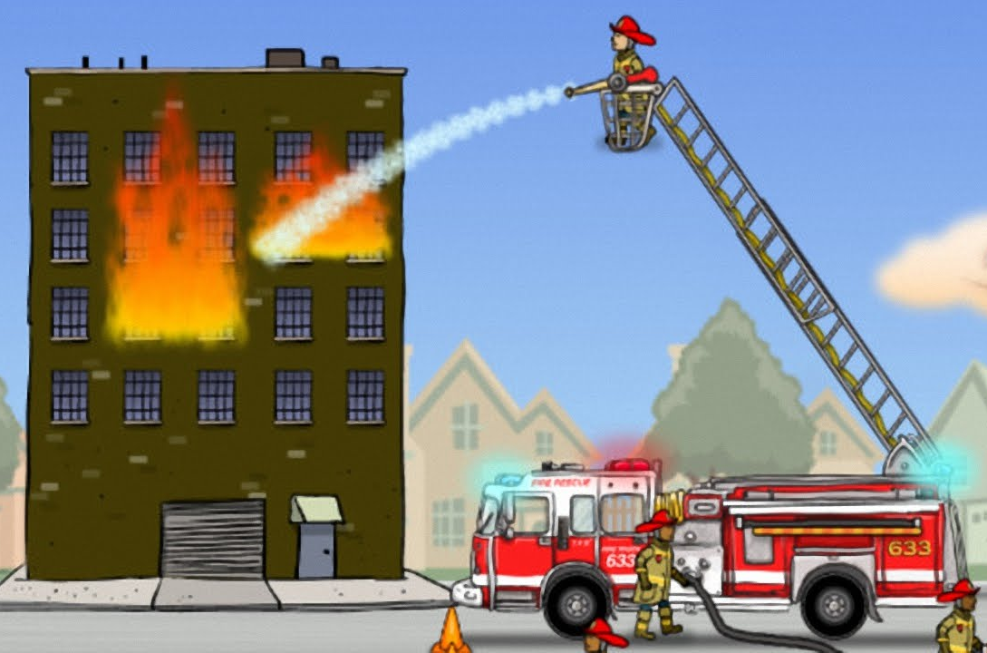

2 Major Coverage Parts
Property
Pays business owner when property is damaged (e.g., fire or flood)
Liability
Pays injured person for negligence of business owner.

Slide 6
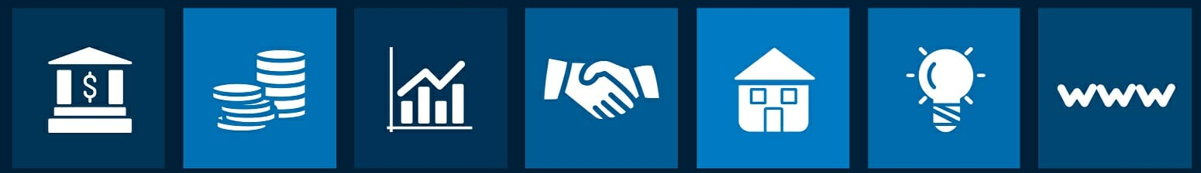
WHAT IS LIABILITY?
Property Owners have a duty to protect people on their premises for legitimate purposes from harm. Failure to do so makes the property owner legally responsible.
You can also be liable to other for injuries and damage that occurs away from home.

Slide 7




Negligence Defined
Insured fails to exercise reasonable care that a prudent person would exercise under similar circumstances.
(e.g., item spilled on floor, not cleaned up and someone slips and falls – becoming injured)

Slide 8


Major Parts Of An Insurance Policy
Declaration Page (dec page)
Definitions
Insuring Agreement
Conditions
Exclusions

Slide 9



Who Is An Insured?
Individual owner, partner or corporation.
Spouse of owner for business activities.
Employees of the business.

Slide 10

Which Properties Are Covered?
Office, apartment and other small commercial buildings.
Completed additions to the building.
Permanent fixtures – blinds, drapes, lights, equipment.
Personal property – contents of business including leased equipment (e.g., copiers).
Property of others that business is working on – dry cleaner.
Improvements to property done by tenant.

Slide 11

Business Income / Extra Expense
When the business owner has a loss and can’t conduct his business, the BOP will cover his loss of revenue and/or the additional expenses to stay open.
Insurance companies pay net income which is sales minus expenses for 12 months.

Slide 12
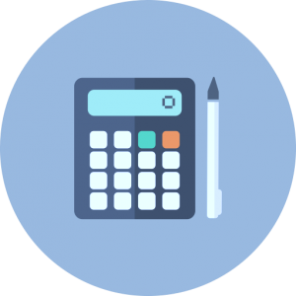
BOP MATH EXERCISE
Sheila’s Sporting Goods had a fire, so she was forced to close her store for one month.
If a fire had not occurred, her revenues would have been $30,000.
For the month Sheila’s records show:
Continuing Expenses $8,500 – mortgage, etc.
Non-Continuing Expenses $3,000 – salaries, electricity, etc.
What dollar amount will Sheila recover?
Notes:
Answer: Revenue $30,000 minus non-continuing expenses $3,000 = $27,000 paid out.

Slide 13

Business Income Replacement
Extra Expense pays for expenses the business owner incurs to continue his business after the loss (e.g., temporarily renting another space).
Civil Authority pays for the loss of revenue (up to three weeks) when the authorities prohibits access to your property due to loss at someone else’s property (e.g., fire department blocks off a street).
Business Income from Dependent Properties pays for loss of revenue when a major business you depend on for your business to be successful has a loss impacting you (e.g., major store next to you has fire and now you don’t have as many customers).
All three of the above have a 72-hour deductible before the loss is paid.

Slide 14

Robbery / Theft – Additional Coverages on BOP
Money & Securities – this is not covered, so business owner must purchase additional coverage. Covers robbery, burglary of money.
Employee Dishonesty – businesses can buy additional coverage to protect themselves against employees stealing from the business.

Slide 15


Property Exclusions on BOP
Special Form or “Open Perils”— everything is covered except what is excluded.
Insurance companies exclude things that are:
Catastrophic (e.g., nuclear)
Intentional or maintenance of item (e.g., wear and tear)
Better insured under another policy (e.g., flood)
Exception to exclusions is “following a fire”

Slide 16

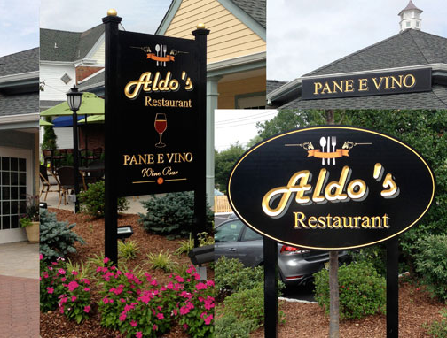
Insurance Limits
Outdoor Signs – $1,000
Automatic Building Limit Increase – 8%
Increase 25% for seasonal property
Deductibles – amount business owner pays

Slide 17


Tips if You Have a Loss in Your Business
Notify Police
Call your Insurance Agent
Give description of loss – how, when, where
Protect property from further damage
Provide list of damaged property
Cooperate with insurance company
Resume your business ASAP

Slide 18



Amount of Insurance Required
Your Business Owner’s Policy replaces damaged items provided you carry enough insurance.
EQUATION:
Value to Replace Building X Coinsurance Percentage

Slide 19

BOP MATH EXERCISE #2
Building’s replacement cost is $1,000,000
Coinsurance is 80%
Insurance policy has $400,000 building coverage
How much will insurance company pay?
EQUATION
Building limit______ x Coinsurance _____ = ______
Insurance Policy limit ______ divided by # above ________
This is amount of each loss that will be paid
How much will the insurance company pay?
Notes:
Answer: 50%

Slide 20
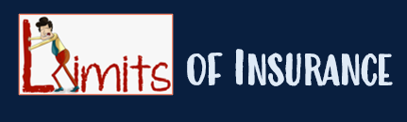


Per Occurrence Limit = usually 1,000,000
Per Person Limit = usually $5,000
Aggregate or Total Limit = usually $2,000,000
(Insurance) Food for Thought –
Customer slips and falls and incurs $3,000 in medical expenses.
Jury awards $800,000 due to business owner’s negligence.
Glad you have a good Business Owner’s Policy?

Slide 21

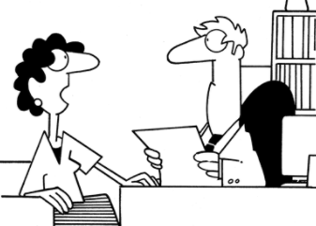
Business Owner’s Policy Exclusions
Expected or Intended Injury
Workers Compensation
Aircraft, Auto or Watercraft
Mobile Equipment
Professional Services

Slide 22
Does Business Interruption Insurance Cover PANDEMICS?
Business interruption insurance, also called business income insurance, helps small businesses protect against monetary losses due to periods of suspended operations when a covered event, such as a fire, occurs and causes physical property damage.
This coverage allows businesses to pay fixed expenses, including costs of operating at an offsite location while the primary location is being repaired. Policies also reimburse business owners for lost revenue from a business being closed.
THE ANSWER: No. Exclusions from coverage include losses unrelated to property damage, such as lost revenues due to outbreaks or pandemics.

Slide 23
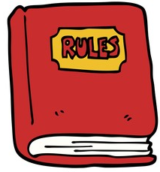
Common Insurance Company Policy Rules
Cancellation – business owner can cancel by calling agent or writing insurance company. Insurance company must give prior notice to business. owner to cancel.
Concealment, misrepresentation or fraud – business owner must be honest, or this could jeopardize the policy or have claims rejected.
Examination of books and records – insurance company can audit insured's financial records.
Inspection and surveys – insurance company can inspect property for safety and exposures to risk.
Transfer of rights to recovery – insurance company can sue or collect from someone else who may be responsible for the loss.

