Slide 1




PERSONAL AUTO POLICY
© Copyright Invest 2021

Slide 2
What you will learn
Sections of the auto policy – declaration page, insuring agreement, definitions, conditions, exclusions and endorsements.
Who can purchase a personal auto policy, summary of coverages and definitions of terms.
Understand Parts A-F of personal auto policy coverages.
Information about Uninsured Motorists Coverage.
Cancellation Provisions.
Module 7
Learning Objectives
© Copyright Invest 2021

Slide 3



Before you drive that car off the lot
You must have auto insurance – it’s the law. Remember: an insurance policy is a legal contract. Typically, a personal auto policy covers those who own or lease private passenger cars, but not vehicles used for commercial purposes.
Key sections of the Personal Auto Policy:
The Declarations or “Dec” page
Insuring agreement
Definitions
Conditions
Exclusions
Endorsements
© Copyright Invest 2021
Notes:
The declarations page is the front page of the policy where you will find the name of the person or persons insured, address, description of cars covered in the policy, and other personal information. It is called a declarations page because it contains information that is declared by an applicant to the insurance company when applying for a policy. Often just called the “dec” page.
The insuring agreement is a brief, broad statement of the insurance company’s obligations in the policy along with the responsibilities of the policyholder. May say something like: “If you (the insured) agree to pay your premiums, we (the insurance company) will pay your covered claims.”
Definitions is a glossary of terms in the contract (policy) which have special meaning and are emphasized either by italisc, bold-face type or quotation marks.
Conditions means that insurance policies are conditional contracts and the company is not obligated to pay all losses suffered by the insured. Coverage is only provided under certain conditions. For example, U.S. auto policies do not cover losses out of the United States so if you’re driving in Europe, for example, you must by special international insurance coverage.
Exclusions are designed to eliminate coverage that should be covered by other policies or events such as catastrophic or an uninsurable event like a nuclear war. The goal is to keep the cost of an insurance policy reasonable by covering those events that are most likely to affect a policyholder.
Endorsements are policy changes that may be specific to a particular policyholder and could be covered by an insurance company. For example, roadside assistance for towing if your car breaks down would be an endorsement.

Slide 4

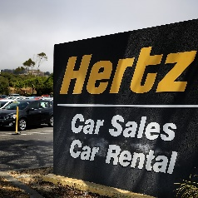
Coverage A – Liability coverage
There are several more sections in a personal auto policy including liability coverage.
Liability Coverage provides protection when:
You or a family member is driving your own car – “your covered auto.”
You drive someone else’s vehicle.
Someone drives your car with your permission.
You’re driving a rental vehicle.
You’re driving any vehicle.
© Copyright Invest 2021
Notes:
Liability coverage provides protection when you are held legally responsible to others for injury or property damage caused by an auto accident. Note that you are covered for liability when you use any auto: you have coverage under your own auto policy while driving your own car, when you borrow a friend’s car, or when you rent a car. People who use your car with your permission are covered by your policy. For example, you loan your SUV to a friend who using it to go skiing. While returning home, he has a crash with another car and is responsible for the crasha nd several people in the other car are injured. Under this scenario, the people in the other car would be covered under your personal auto policy.

Slide 5
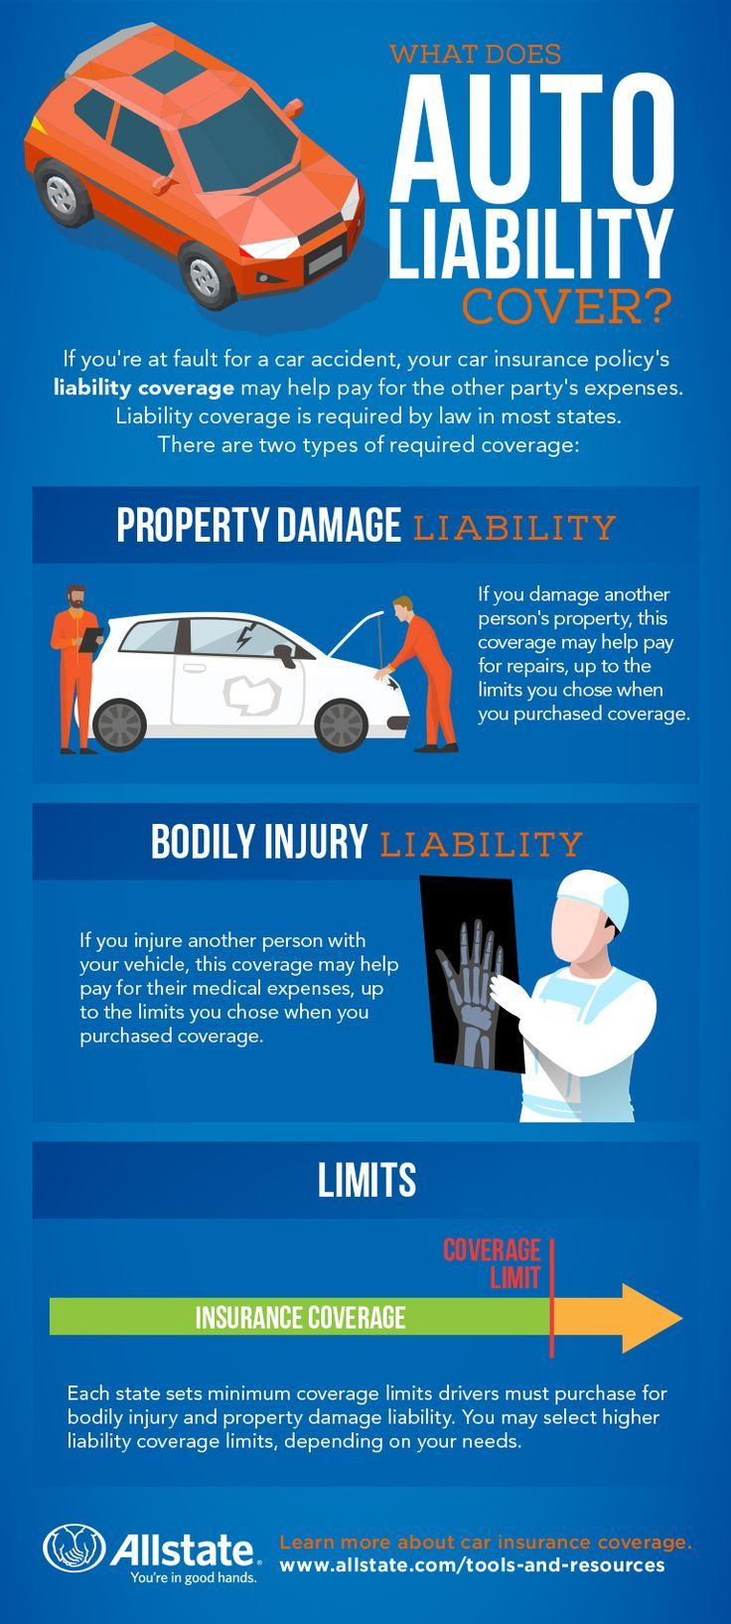
Key terms under Liability coverage
Courtesy of Allstate
© Copyright Invest 2021
Notes:
Here are some key terms you will hear when discussing liability coverage.

Slide 6



I just bought a car – am I covered by insurance?
Step 1 – Call your insurance agent or company BEFORE you purchase any auto.
Helpful hints at the car dealership:
If you trade in your vehicle, you should have the same coverage for your next vehicle BUT:
For a new car you may want to increase your coverage. (e.g., buy comprehensive & collision coverage)
What if I don’t trade the vehicle in but purchase another vehicle – Is there coverage for this new vehicle?
Call your insurance agent or company to make sure you have the right amount of coverage to protect your car.
© Copyright Invest 2021

Slide 7

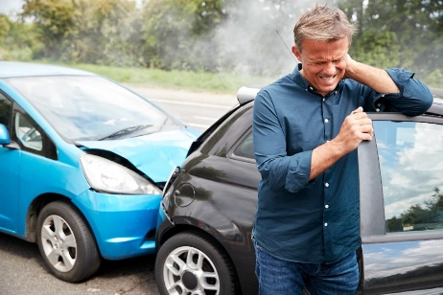
Coverage B – MEDICAL Payments
Coverage provides medical payments for you and your passengers with injuries from an auto accident.
Payments cover:
Medical expenses for you and your passengers in a car crash.
You as a passenger in another vehicle or if you are hit by a vehicle as a pedestrian.
Injuries without regard to who’s at fault in an accident.
Injuries from getting in or out of the vehicle.
© Copyright Invest 2021
Notes:
Note that the limit for medical payments applies per person and there is no limit on the number of people it covers. Most people purchase coverage between $1,000 and $5,000 per person coverage but higher limits are available.

Slide 8
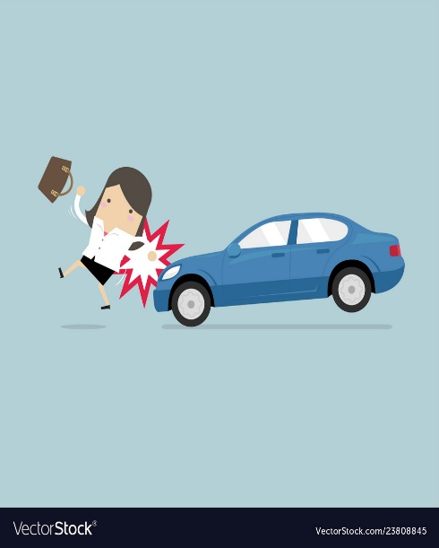


Coverage C or What Happens If I Get HIT By a *U-M?
Uninsured motorist coverage pays for your damages if you’re hit by someone without insurance.
Also U-M pays if you are hit by a hit-and-run driver.
It even covers if you’re struck as a pedestrian and the vehicle doesn’t have insurance.
The MOST important condition for coverage to apply is that the other person must be at fault!
Limits are usually the same as liability limits. It’s important to have both higher liability limits and higher uninsured motorist limits.
*Uninsured Motorist
© Copyright Invest 2021
Notes:
Yes, it’s true, there are some people out there driving who DO NOT HAVE INSURANCE COVERAGE or have less coverage than they need. While it is highly illegal not to have insurance coverage, it happens so you can buy coverage to insure yourself against a UM. Otherwise, you have to pay for the damages. UM is not required in every state but it is smart to have it or you could be left footing the bill.

Slide 9

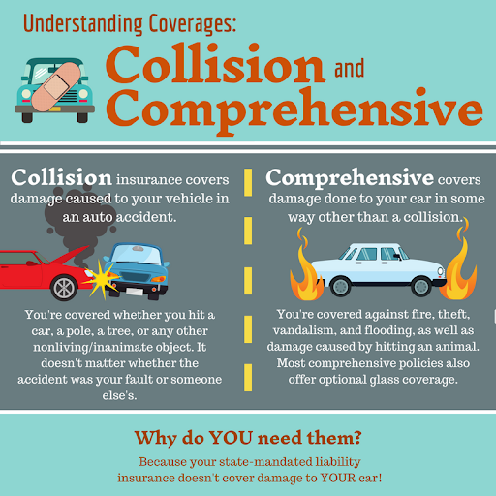

Coverage D – Collision and Comprehensive
aka: Damage to your new BMW
Coverage D always comes with a deductible — the amount you need to pay when you have a covered loss to your car.
Courtesy of Safe Harbor Insurance
© Copyright Invest 2021
Notes:
Not covered under collision or comprehensive is a flat tire or a blow out, a mechanical break down or maintenance on your car. It is important to note that Part D is not a required coverage and if you have a very old car with little value, you may not need to purchase Collision or Comprehensive. If you had a newer, more expensive car, it would be worth buying this coverage. Under Part D, there is a deductible – i.e. an amount you must cover before any insurance claims is paid. Typically the deductible is $100, $250, $500 or $1,000 per each loss. Note that the higher your deductible, the lower the insurance premium.

Slide 10
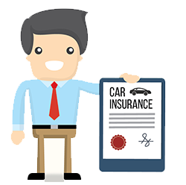

Parts E & F – Your responsibilities if you have a claim
As part of your auto insurance policy, you’re required to notify your insurance agent or company when you have a claim. Your responsibilities include:
Tell your insurance agent or company about when and where the accident happened, names of those involved or injured in the accident, as well as names of witnesses.
Cooperate with the insurance company as they work to resolve your claim. Provide additional information about the accident as requested.
Notify the police if struck by a hit-and-run driver or if your car is stolen.
Allow the insurance company’s claims adjuster to inspect the damage to your auto prior to repairs.
© Copyright Invest 2021
Notes:
After an accident, you should call your insurance agent or company as soon as possible to report a claim, determine what happened and evaluate damages and/or injuries. A claims adjuster will be assigned to your case to work to resolve your claim. Often determining is at fault (liability) can take some time. The amount of money you will receive for your loss will depend of the claims adjusters’ analysis of your accident. Remember: you are not required to accept the first offer from the claims adjuster, especially if the offer is lower than the cost to repair your car. Keep an open mind when working with your claims adjuster to settle on a price that’s both fair to you and your insurer.

Slide 11
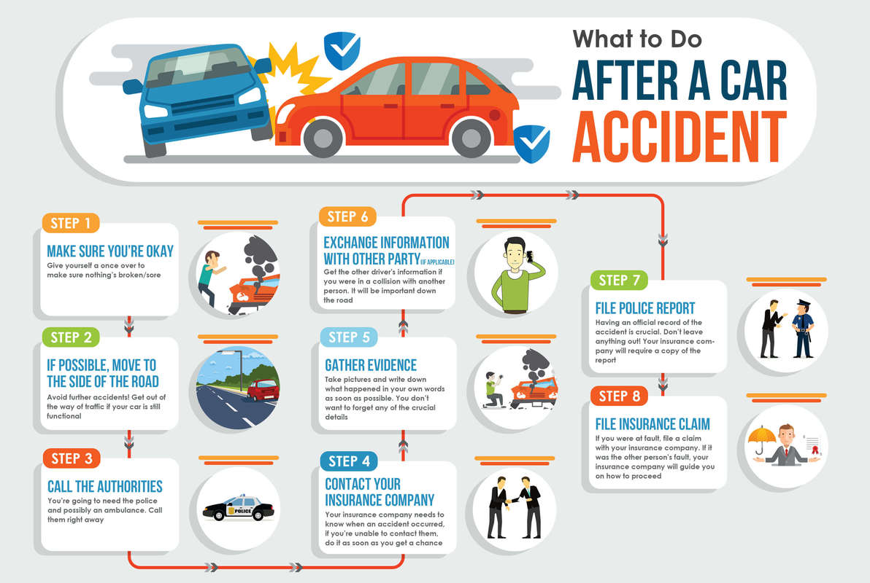
Eight important steps
Courtesy of Law Technology Today
© Copyright Invest 2021
Notes:
Always keep your insurance information with you at all times…in your car or in your wallet or purse. If your accident is on a busy road, step away from the car and out of the way of traffic. Many people have been injured when standing next to their car after an accident.

Slide 12

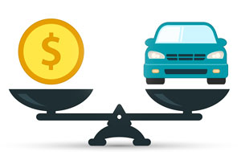
ACTUAL CASH VALUE (ACV)Of Your Car
Your car is considered “totaled” if the cost to repair your car is more than its actual cash value.
Insurance companies use fair market value sources such as the Kelly Blue Book to determine the actual cash value of your car.
Gap coverage.
New car replacement .
© Copyright Invest 2021
Notes:
The ACV or actual cash value of your car is the amount your car insurance company will pay you if it’s stole on totaled in an accident. It is true that your car loses value the moment you drive it off the lot. Gap insurance and new car replacement coverage are additional coverage options you can buy that help you if your car is totaled. Gap insurance covers you if your car is totaled and you are still making loan payments on your car or you have a car lease that you are still paying for yet you have no car. It will pay off the gap between the ACV of your car and the amount you still have left to pay on your loan or lease.
New car replacement is usually only available to cars if you’re the first owner and it is less than one or two years old (depending on your policy). New car replacement coverage pays out more than the ACV of the car if it is totaled and you will be allowed to replace your totaled car with a new car of an identical or equal make or model.

Slide 13

Compensation of Auto Accident Victims
Under our legal system, people who suffer injuries or have their property damaged as a result of automobile accidents are entitled to some form of compensation.
© Copyright Invest 2021

Slide 14
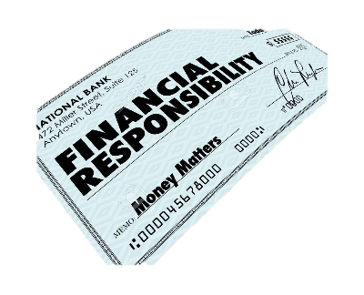
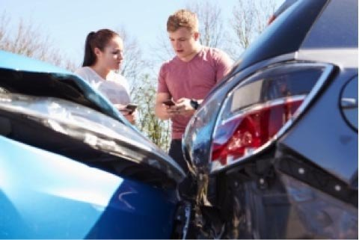
Every State Has A Financial Responsibility Law
These laws require a person to provide proof that they are financially responsible in the following circumstances:
Following an accident in which someone is injured.
If there’s been property damage in excess of a certain amount, usually $500.
After conviction for a serious driving offense, such as DUI, reckless driving or vehicular manslaughter
When a driver’s license has been suspended or revoked, prior to its reinstatement
If the driver has failed to pay money owed from previous accidents.
© Copyright Invest 2021

Slide 15
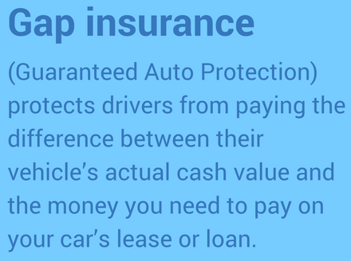
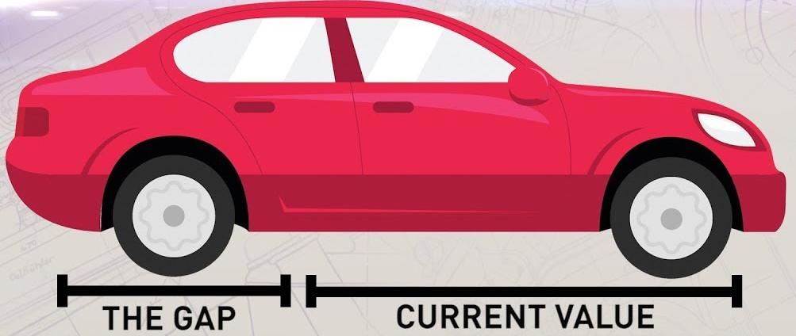
What About…
Courtesy of Pawson Insurance
© Copyright Invest 2021

Slide 16
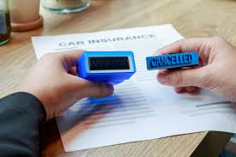
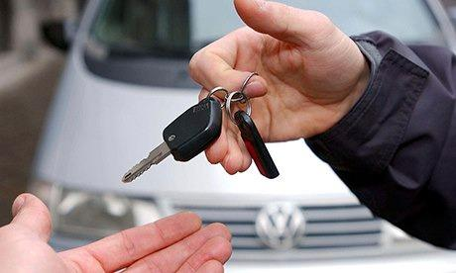
Who can cancel an auto policy?
You may cancel your auto insurance at any time by notifying the insurance company or insurance agent.
The insurance company may cancel your insurance if you fail to pay the premium or have your drivers license suspended or revoked. The insurance company must send your cancellation notice by mail or electronically.
© Copyright Invest 2021

Slide 17
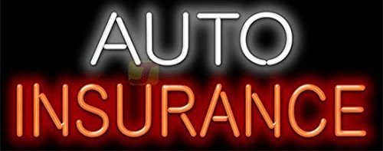


Okay, I learned a lot about… So how do I get a policy?
Your insurance agent or company will request:
Driver’s age
Number of tickets
Number of accidents
Type of vehicle
Age of vehicle
Number of miles driven each year
Apply
for Car
© Copyright Invest 2021
Notes:
Make sure you are honest about everything in your application. Not telling the truth might jeopardize your insurance coverage and if you have a claim, it could be denied if you are dishonest. Note that if you are a bad driver, you can still get auto insurance but the cost will be extremely expensive so it’s best to maintain a good driving record.

Slide 18

What happens next to my application?
Your application goes through an underwriting process.
Underwriters can accept or reject your application.
If your application is considered risky (ex., too many accidents), they can accept your application but recommend a higher cost.
Or, you can reduce the insurance coverage or have a higher deductible.
© Copyright Invest 2021
Notes:
Make sure you are honest about everything in your application. Not telling the truth might jeopardize your insurance coverage and if you have a claim, it could be denied if you are dishonest. Note that if you are a bad driver, you can still get auto insurance but the cost will be extremely expensive so it’s best to maintain a good driving record. It is also important to note that in all states, the insurance company will access your motor vehicle or driving record (MVR) and in some states, insurance companies will run a credit check as part of your application process. Credit check or credit scoring is done because of the belief that a person with good credit will also be a good customer. Insurance companies need to determine the best risk for their company.

Slide 19
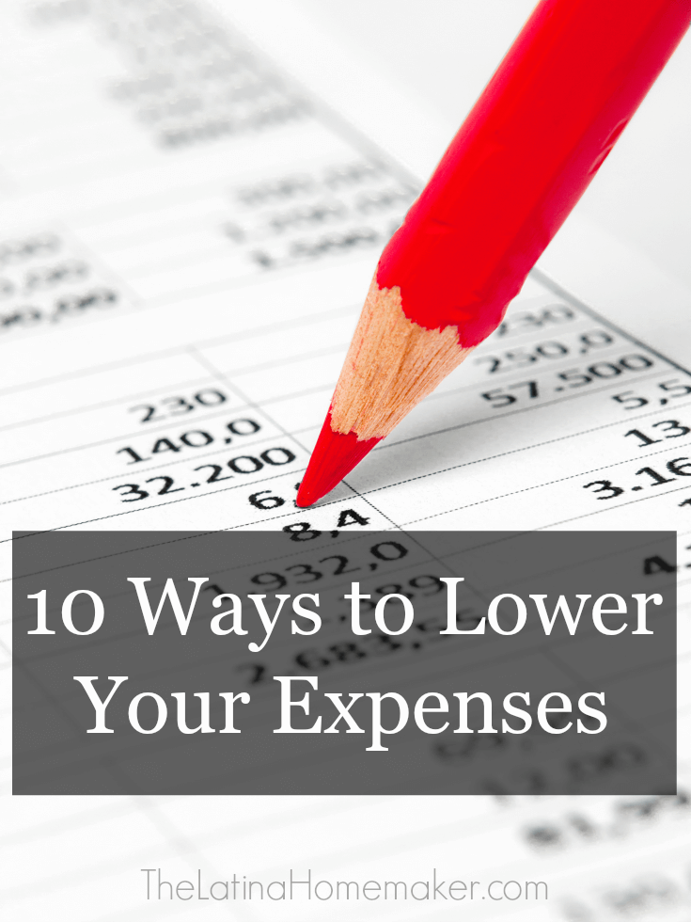

Your Rate
Buy a car with safety features, air bags, back up cameras and warnings, vehicle skid control, side mirrors that warn you about blind spots.
Buy a car with security systems including electronic locks, disabling devices.
Take defensive driving education courses.
Discuss your policy with an insurance agent who can help guide you.
Limit number of miles you drive each year.
Purchase higher deductibles (but you will pay more if you have an accident)
Take advantage of multi-line discounts (purchasing several insurance policies from the same company – e.g., an auto and a renter’s policy.
Avoid getting speeding tickets and points on your license.
Have a good credit rating and maintain it.
Practice safe and responsible driving – they have lower insurance costs.
© Copyright Invest 2021
Notes:
– remember: safe and responsible drivers have lower insurance costs. Here’s how you can lower your rate.

