Slide 1
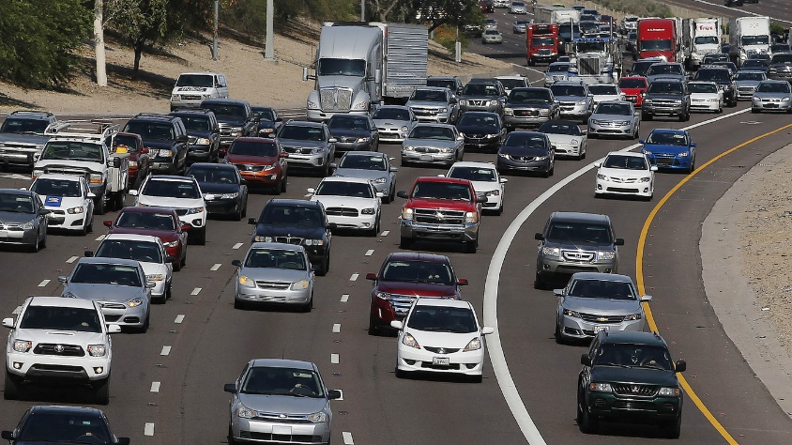


Personal Auto Policy – Costs
Is It Covered or Not?
Notes:
Introduction of the topic and yourself (name, where you work, job title)

Slide 2
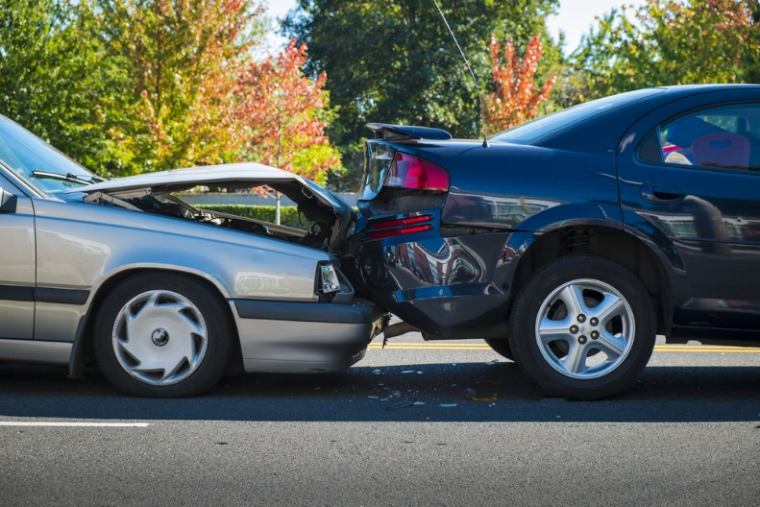
What costs are involved when you’re in an accident?
Notes:
Instructor- ask students- 3 minutes

Slide 3
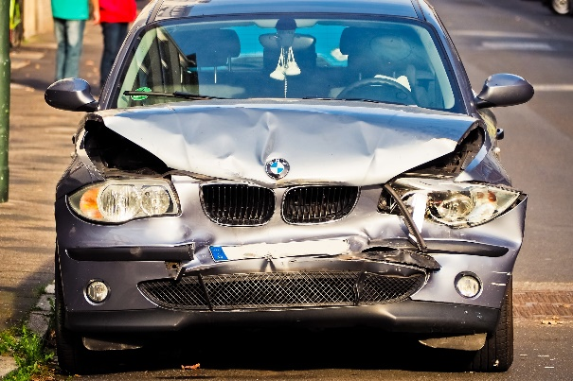
Even a minor accident can result in thousands of dollars in damages
Damage to your car
Damage to other cars involved
Medical bills
Lost wages
Pain and suffering
Prosecution
Legal fees
Fines
- Physical Damage
- Medical Payments
- Physical Damage Liability
- Loss of Income
- Liability – Bodily Injury
Notes:
Instructor-2 minutes- match students answers to coverages in auto policy

Slide 4
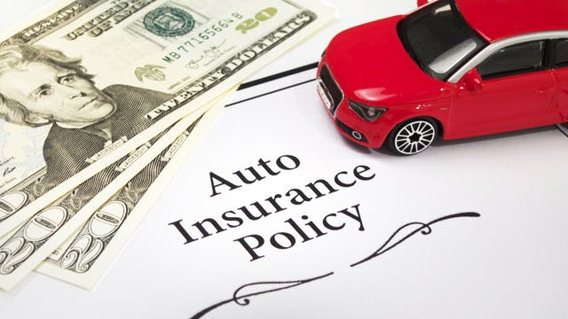
What is Automobile Insurance?
An auto insurance policy is a contract between you and an insurance company
You pay a premium, and in exchange, the insurance company promises to pay for specific car-related financial losses during the term of the policy
Notes:
Instructor- 1 minute

Slide 5
Is It Covered?
Jeff’s 14-year-old son decides to try his hand at driving one night. Unfortunately, his driving was as faulty as his judgment. He hit a parked car near the police station
As long as the policy was in force and the vehicle was listed on the policy, will coverage apply for this loss?
Notes:
Answer: Yes. The insuring agreement states that we will pay all sums for which the insured is legally liable. The insured is defined as any family member regardless of age. There could be some question here as to whether the boy had a reasonable belief he was entitled to drive the car. This exclusion would probably not come into play in this incident.

Slide 6
Liability Who Can Drive Your Car?
Named insured and family members
Anyone you give permission to drive your car
Any person or organization responsible for acts of covered person
Any person or organization responsible for use of auto
Included in Limit
Damages for bodily injury or property damage
Outside of Limit
Defense costs
Notes:
Instructor- 3 minutes- go over Insuring agreement- liability coverage- B.I. and P.D. also give court example of prejudgment and post judgment interest …show what is included in limit and what is not.
We will pay damages for "bodily injury" or "property damage" for which any "insured" becomes legally responsible because of an auto accident. We will settle or defend, as we consider appropriate, any claim or suit asking for damages which are payable under the terms of this policy, even if any of the allegations of the claim or suit are groundless, false or fraudulent. In addition to our limit of liability, we will pay all defense costs we incur. We have no duty to defend any suit or settle any claim for "bodily injury" or "property damage" not covered under this policy.
Information provided by Personal Auto Policy Annotated Table- IIABA Virtual University article

Slide 7
Is It Covered?
Jessica is helping out with a spaghetti dinner at the community center. She is on her way back from the store with needed supplies when she runs into someone at an intersection. It was clearly your insured’s fault
The injured party decides to sue Jessica and the center, since she was on an errand for them. Will the center be protected by Jessica’s policy?
Notes:
Answer: the insuring agreement states that the company will pay damages for which the insured becomes liable. According to definition of an insured #3, any organization which is legally responsible is an insured. Therefore, coverage would be afforded.

Slide 8

Is It Covered?
Alex is helping a friend move her furniture into her new house. On the way to the new house, Alex has to stop the car very quickly and three valuable lamps in the trunk are broken. Will the damage to these lamps be covered by John’s auto liability?
Notes:
Answer: No. Exclusion excludes coverage for any property being transported.

Slide 9
Liability Exclusions
Intentional injury
Property owned or transported
Property rented to, used by or in care of insured
Bodily injury to employee – domestic employee is covered
Public or livery
Notes:
Instructor- 10 minutes
Intentional-There is no coverage for any "insured" who intentionally causes BI or PD. It appears, though, that a majority of courts (as implied by the policy language) appear to apply the exclusion only if there is intent to cause the actual BI or PD. For example, an insured repeatedly struck her employer's auto, causing it to jump out of gear, roll down a hill, and strike another car. The damage to her employer's auto was not covered, but the resulting unintentional damage to the other car was covered.
Owned Property- There is no coverage for PD (direct or indirect loss) to property: (1) owned, or (2) being transported by that “insured.” A key word in this exclusion is “that.” Excluded, for example, would be damage caused by an insured that negligently crashes into his own home since this is usually covered by a homeowners policy. However, assume the named insured loans his auto to a friend who negligently crashes into the named insured’s home—the policy, under the principle of severability of insurance, would cover the damage due to the insured neighbor’s negligence because the home is not owned by that (the neighbor) insured...but the policy would not cover damage if the neighbor crashed into his own home.
Bodily injury to employee-There is no coverage for BI to an employee of that “insured” that occurs during the course of employment, except that BI to domestic employees is covered unless workers compensation benefits are required (presumably by law) or available (presumably actually provided).
Public or livery- exclusion is designed to preclude coverage for vehicles available for hire to the general public for the transportation of people or cargo (e.g., taxis, sight-seeing vans, package delivery services, etc.)
Information provided by Personal Auto Policy Annotated Table- IIABA Virtual University article

Slide 10
Is It Covered?
Tamika works in the same building with four other people from her neighborhood. They decide to start riding to work together.
Since Tamika has the largest vehicle, she agrees to drive all the time. In exchange, the other four people pay her $10 per week. If Tamika has an accident that causes bodily injury to the passengers in another vehicle, is coverage provided by her auto liability?
Notes:
Answer: Yes. Public or livery excludes coverage for carrying persons or property for a fee. This exclusion does not, however, apply to a car pool. Since they are merely sharing the expense of the drive, this would be considered a car pool.

Slide 11
Is It Covered?
Alex decides he would save a little money by insuring only one of his two cars. He heard that he had coverage for driving any car, so Alex figured he didn’t need to insure the second vehicle. If a loss occurs while he is operating the second vehicle, will coverage apply?
Notes:
Answer: No. According to the definitions, this is neither an owned nor a non-owned auto. Therefore, it is not insured.

Slide 12

Liability Coverage Exclusions
Excludes liability for an owned vehicle not insured or a non-owned vehicle furnished for your regular use (company car)
Notes:
Instructor- 10 minutes
There is no coverage for the ownership, maintenance or use of any vehicle (other than “your covered auto”) which is: (1) owned by “you” (e.g., an inoperable "work in progress" or an auto insured elsewhere), or (2) furnished or available for “your” regular use.
Ask Students- why is this exclusion in the policy? This exclusion is designed to exclude primarily: (1) undeclared owned autos, and (2) company cars, although the exclusion is not limited to these examples.
There is no coverage for the ownership, maintenance or use of any vehicle (other than “your covered auto”) which is: (1) owned by any “family member,” or (2) furnished or available for the regular use of any “family member,” except that “you” are covered while maintaining or “occupying” such vehicles.
This exclusion applies to thousands of family situations across the country and presents serious, but often overlooked, exposures to loss. For example, a family consists of two parents, a 19-year-old daughter, and a 17-year-old son, all residing in the same household. Assume the parents insure their autos under Policy A and the daughter insures her auto under Policy B. The son drives the daughter's auto and has an at-fault accident that results in BI to a third-party. The damages are within the Policy A limits, but far exceed the Policy B limits.
Because of this exclusion, the son is not covered by Policy A, his parent's policy, even though he is a resident family member. He would be covered if he borrowed a neighbor's car, but not his sister's auto. This creates a serious exposure (including an E&O exposure) because it is much more likely that the daughter will have low(er) limits or no coverage at all.
Information provided by Personal Auto Policy Annotated Table- IIABA Virtual University article

Slide 13
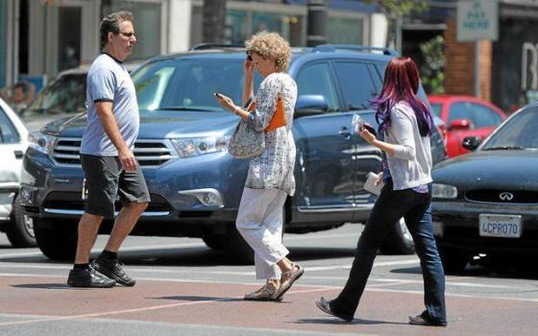
Is It Covered?
Cameron calls to tell you he has been involved in an accident. He was driving his friend’s car, lost control and hit a pedestrian. His friend has auto insurance and Cameron has auto insurance as well. Which policy would pay? Do both pay?
Notes:
Answer: According to Other Insurance, any coverage provided for a non-owned vehicle will be excess. Therefore, the coverage from the friend’s policy will be primary, and your insured’s policy will be excess.

Slide 14
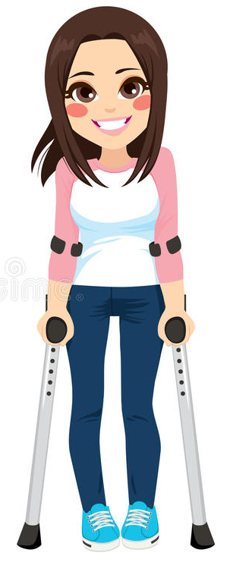
Is It Covered?
While walking down the street with her family, Allison is stuck by a vehicle that comes up on the sidewalk Would this be covered and on whose policy?
Notes:
Answer: Yes. Medical Expense coverage applies to this insured’s injuries. The definition of an insured includes an insured or a family member while a pedestrian.

Slide 15
Medical Expenses
Medical payments coverage under a Personal Auto Policy is similar to an accident policy... if the injured person is an "insured," it pays without regard to liability or fault
Reasonable and necessary medical and funeral costs due to accident
Within 3 years
Medical, surgical, x-ray, dental and funeral services
Range from $1,000 to $10,000 per person
Notes:
Instructor- Medical Payments coverage can be viewed as a form of "no-fault", or accident and health (A&H), insurance-coverage applies without regard to legal liability so long as: (1) the insuring agreement is triggered, (2) the injured person is an "insured", and (3) no exclusion or restrictive condition applies.
The primary purposes of medical payments coverage are to: (1) ensure prompt attention to injuries, (2) minimize the likelihood of third-party lawsuits,
In most states, Medical Payments coverage is optional, although it cannot normally be purchased without liability coverage.
Note that, unlike Liability coverage Part A, this coverage is triggered just by an "accident," not necessarily an "auto accident." While the definition of "insured" implies that a motor vehicle must be involved, it does not require that the motor vehicle necessarily cause the accident.
Information provided by Personal Auto Policy Annotated Table- IIABA Virtual University article

Slide 16

Is It Covered?
While using his Toyota for his business, Enrico is injured when he slams his hand in the car door Would Enrico’s Medical Expense Coverage apply?
Notes:
Answer: Yes. The insuring agreement provides coverage for anyone occupying the covered auto. Occupying includes getting out of the vehicle.

Slide 17
Is It Covered?
Lamar is injured by a driver who provides the insured with false information. When the insured tries to contact the person’s insurance company, it becomes clear that they have never heard of the person who hit Lamar
When they try to call this person, they discover he has given them a fictitious phone number and address. It is apparent that Lamar will not be able to find the person who hit him Can he get any coverage from his own policy?
Notes:
Answer: This would probably be treated as a hit and run driver, which means there would be coverage under the insured’s UM Coverage. If the insured also carries Medical Expense Coverage, he can recover his medical expenses; however, any amount paid under Medical Expense would reduce the UM payment. There is also a $200 exclusion in UM for damage caused by a driver who cannot be identified.

Slide 18
Uninsured Motorist (UM)
Uninsured Motorists and/or Underinsured Motorists (UIM) coverage is liability insurance to protect the insured from persons who fail to maintain liability coverage or chose lower liability limits than their own policies
The other party must be legally responsible
Pays medical expenses, rehabilitation, lost wages, pain and suffering
Property damage subject to deductible
Notes:
Instructor- All states offer BI UM/UIM coverage, but only about half of states offer a PD option. "Property damage," defined to include injury to or destruction of: (1) "your covered auto" (2) tangible property in "your covered auto" or (3) any other tangible property, except a motor vehicle, owned by an “insured" and located in Virginia.
Information provided by Personal Auto Policy Annotated Table- IIABA Virtual University article

Slide 19
Is It Covered?
John decides to make a little extra money on the accident he was involved in. The person who hit him agreed to pay him $2,500 if he would not report the loss to his insurance company
John agrees and accepts the payment. He then decides to report the claim. During the investigation the company discovers that he accepted the $2,500 Would they pay?
Notes:
Answer: It could be very easily argued that the insured settled the claim without the consent of the insurer. If this is the case, then coverage is excluded.

Slide 20
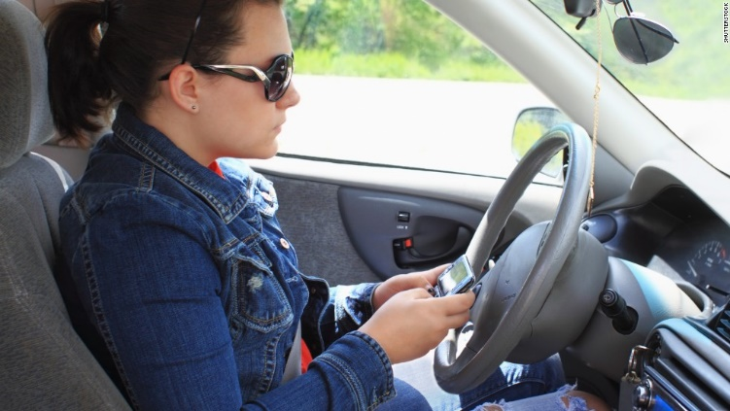
Is It Covered?
While Penny is on vacation, she rents a vehicle to see the sights. While driving down a scenic street, she is not paying attention and she rear ends someone Will Penny’s auto policy respond to the damage to the rented vehicle?
Notes:
Answer: Yes if she remains in U.S. The vehicle she has rented is considered a non-owned auto. The insuring agreement provides coverage for all owned and non-owned autos.

Slide 21

Physical Damage Coverage
Other than Collision – Comprehensive Loss caused by the following is considered other than "collision“
Missiles or falling objects
Fire
Theft or larceny
Explosion or earthquake
Windstorm
Hail, water or flood
Malicious mischief or vandalism
Riot or civil commotion
Contact with bird or animal
Breakage of glass
"Collision" means the upset of "your covered auto" or a "non-owned auto" or their impact with another vehicle or object.
If breakage of glass is caused by a "collision“ – you may elect to have it considered a loss caused by "collision"
Notes:
Instructor- 3 minutes-Collision requires an impact with another vehicle or object, or the overturn of the auto. Situations arise where pieces of the subject vehicle (e.g., hood, blown tire, muffler, etc.) come loose and damage the auto. The general consensus is that, if the piece becomes detached and strikes the auto, it is a collision; otherwise, the damage falls under the Other Than Collision (OTC) coverage.
OTC coverage is provided on an "all-risks" basis...any non-collision physical damage to an auto is considered to be an OTC loss unless otherwise excluded. The list of "perils" (fire, theft, etc.) included within the OTC coverage are not the only perils that constitute OTC coverage...OTC is not named perils coverage. The list is provided just to clarify that, even if they result from a collision, these types of losses are defined to be OTC losses.
The last provision clarifies that glass breakage resulting from a collision can be considered part of the collision loss. This prevents the insurer from applying two separate deductibles...one for the collision and one for the OTC glass breakage.
Information provided by Personal Auto Policy Annotated Table- IIABA Virtual University article

Slide 22
Is It Covered?
John parks his car in a parking garage. When he returns, his GPS system that was permanently installed under the dash is gone
Also missing is his Bluetooth system which was temporarily mounted to the console
John has Comprehensive Coverage What, if any, of this loss is covered?
Notes:
Answer: Coverage is excluded for sound reproducing equipment not permanently installed. Since the GPS unit was permanently installed it would be covered. However, coverage for any bluetooth excluded unless it is permanently installed in the opening of the dash the manufacturer would use for a radio.

Slide 23

Electronic Equipment Exclusion
Loss to any electronic equipment that reproduces, receives or transmits audio, visual or data signals. This includes but is not limited to:
Radios and stereos
Tape decks
Compact disk systems
Navigation systems
Internet access systems
Personal computers
Exclusion (4) does not apply to electronic equipment that is permanently installed in "your covered auto" or any "non-owned auto"
Loss to tapes, disks or other media used with equipment described in Exclusion (4) is also excluded.
Video entertainment systems
Telephones
Two-way mobile radios
Scanners
Televisions
Citizens band radios
Notes:
Instructor- 5 minutes- Language is 2005 PAP policy. Advise students that the wording may vary by company and it is important to look at the wording before deciding coverage.

Slide 24


