Slide 1

Logo Game
Chapter 3-A

Slide 2
The Right Logo
Logos give people the first impression about your company
Be sure it fits your identity
Choose colors that appeal to the target audience

Slide 3
Famous Logos
Many of the well-known company logos are recognizable by viewing only a small portion of it
Can you guess which ones?

Slide 4

Do you know this logo?
Pinterest

Slide 5
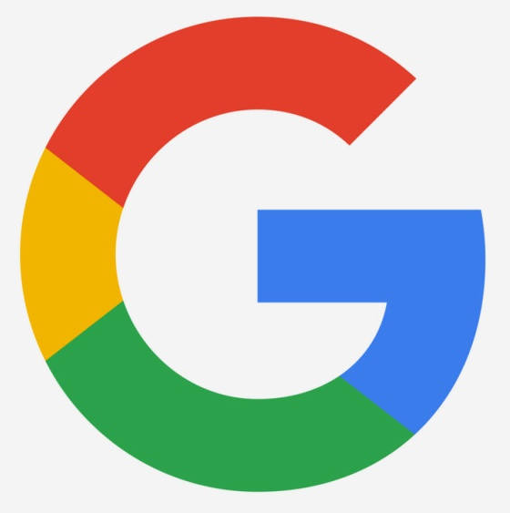
Do you know this logo?

Slide 6
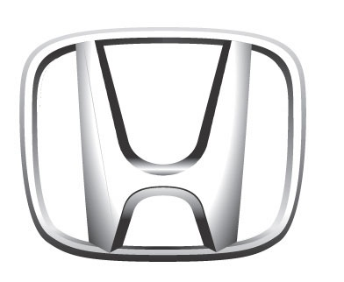
Do you know this logo?

Slide 7

Do you know this logo?

Slide 8
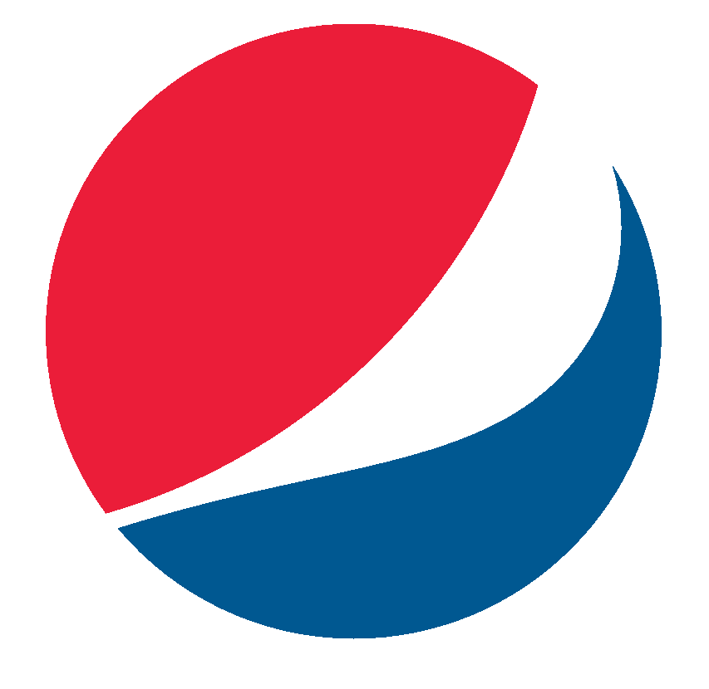
Do you know this logo?
Pepsi

Slide 9
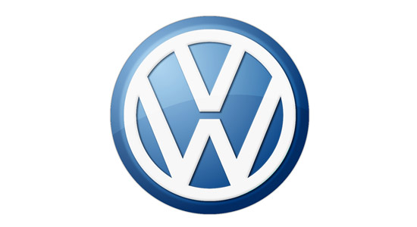
Do you know this logo?

Slide 10

Do you know this logo?

Slide 11

Do you know this logo?

Slide 12

Do you know this logo?
Chanel

Slide 13
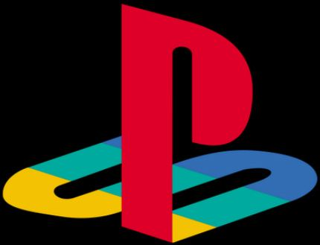
Do you know this logo?
PlayStation

Slide 14

Do you know this logo?
Target

Slide 15
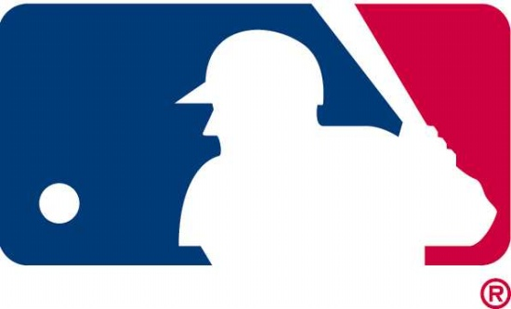
Do you know this logo?

Slide 16
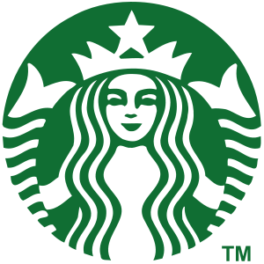
Do you know this logo?

Slide 17
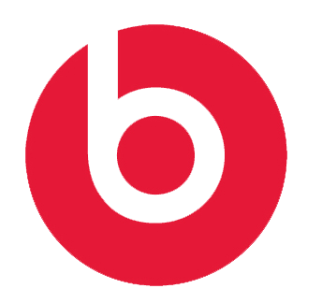
Do you know this logo?
beat

Slide 18

Do you know this logo?
Adidas

Slide 19
Taglines and Slogans
Slogans are a way for a potential customer to immediately understand the mission of your company
They should be easy to remember and include as few words as possible
Be precise and concise so the consumer is not confused about your brand

Slide 20
Who does this tagline/slogan belong to?
Are you in good hands?
A: Allstate
What’s in your wallet?
A: Capital One
The fabric of our lives
A: Cotton Incorporated
The best a man can get
A: Gillette
Because I’m worth it
A: L’Oreal

Slide 21
Who does this tagline/slogan belong to?
Good to the last drop
A: Maxwell House
Made from the best stuff on Earth
A: Snapple
The few, the proud, the…
A: Marines
You’re now free to move about the country
A: Southwest Airlines

Slide 22
Other Insurance Brands
Zurich Slogan: Zurich. Because Change HappenZ.
MetLife Slogan: Have you met life today?
State Farm Insurance Slogan: Like a good neighbor, State Farm is there.
Travelers Slogan: Better coverage for what’s important to you.

